Slide 1
District Finance Training
Session No. 2
March 17, 2023

Slide 2

Welcome
&
Training Overview
Welcome & Recognition
Training Sessions & Resources
Session 2 Topics: Categorical Funds, Leave Banking, Enrollment Revenues, 50% Law, Student Receivables, Bad Debt Calculation, Gann Limit
Asking Questions
Evaluation

Slide 3
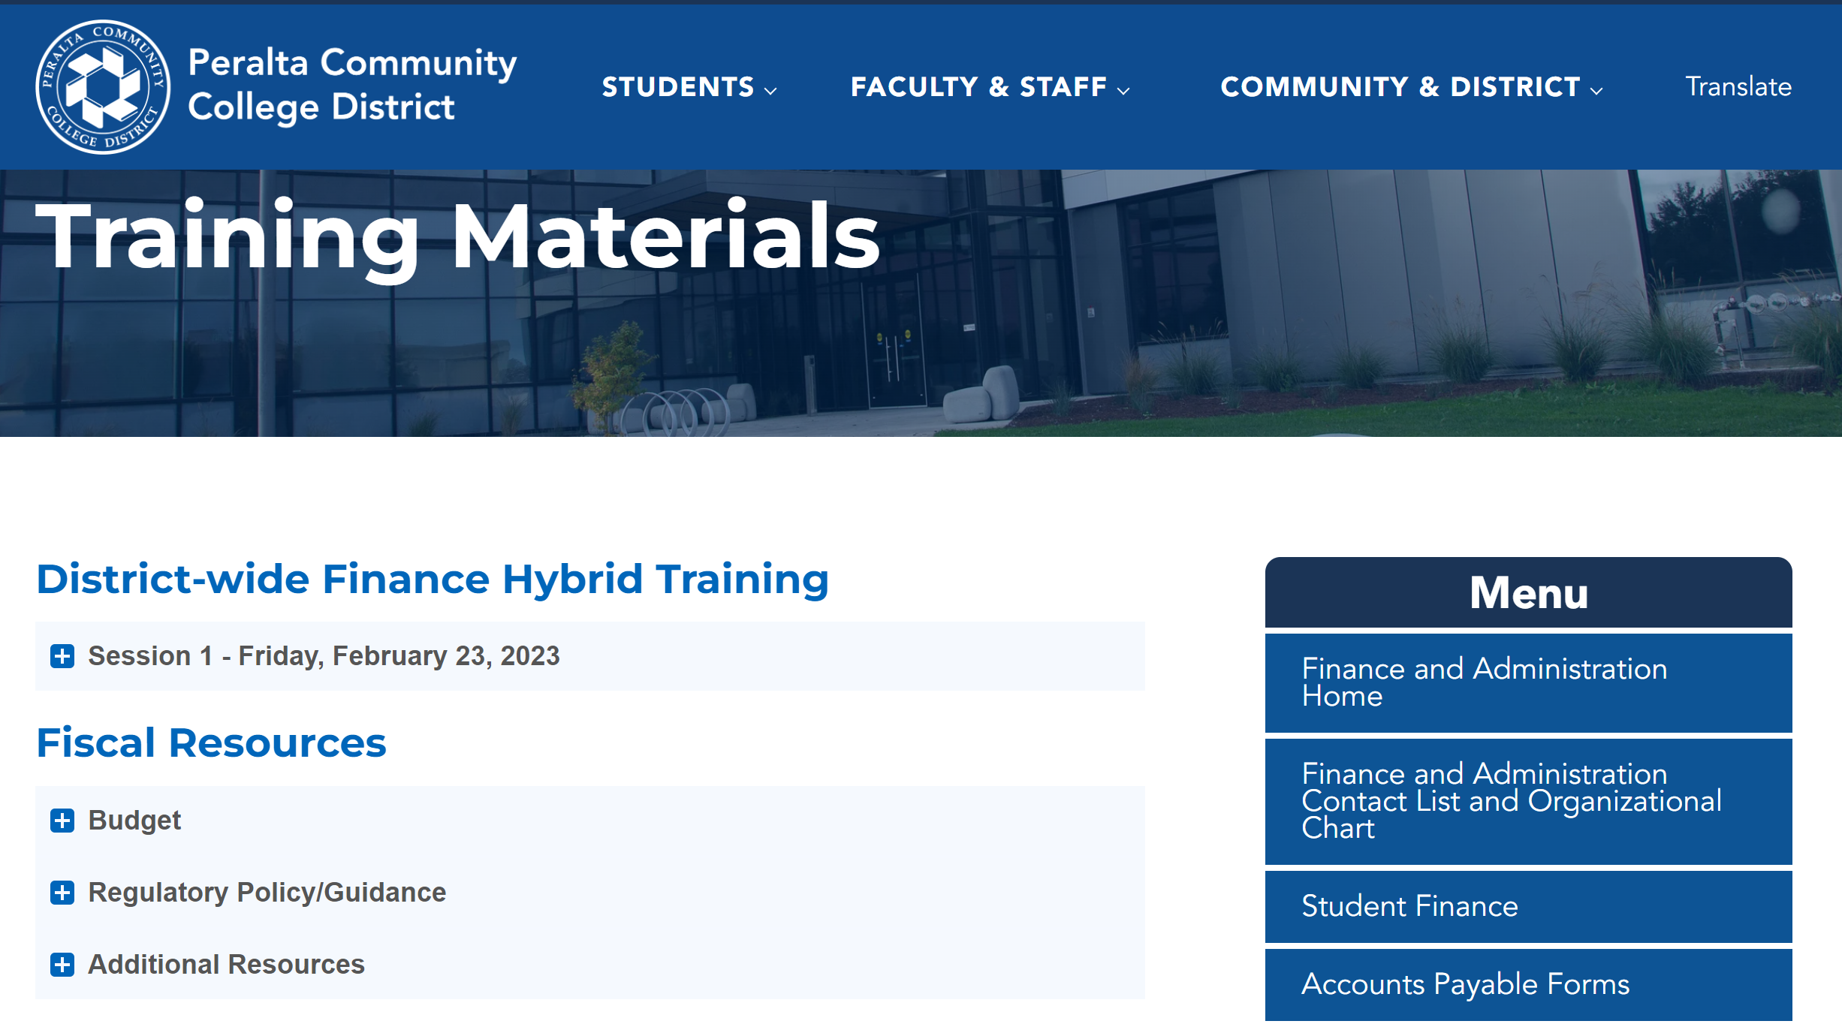
Training Resources
https://www.peralta.edu/finance/training-materials

Slide 4
Project Expense - Categorical Funds
Presenters:
Ofelia Mendoza, District Accounting Technician
Adil Ahmed, Associate Vice Chancellor of Finance and Administration

Slide 5
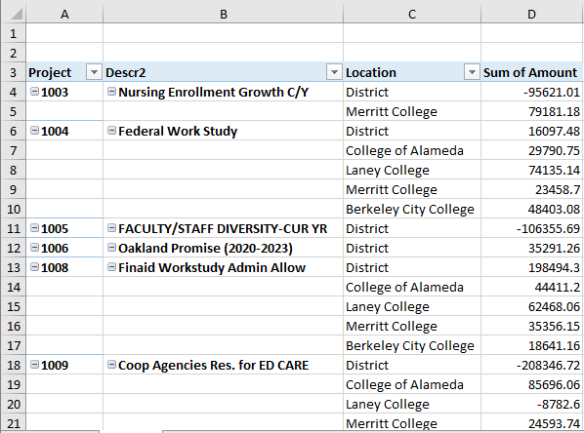
Project Expense Categorical Funds

Slide 6
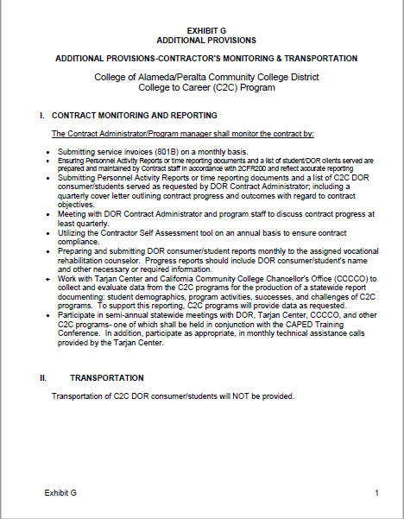
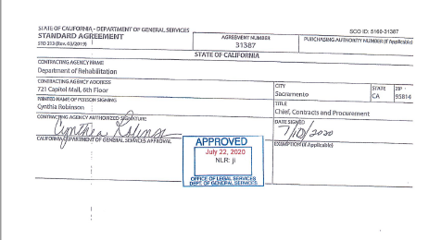
Contract Agreement or Memorandum of Understanding

Slide 7
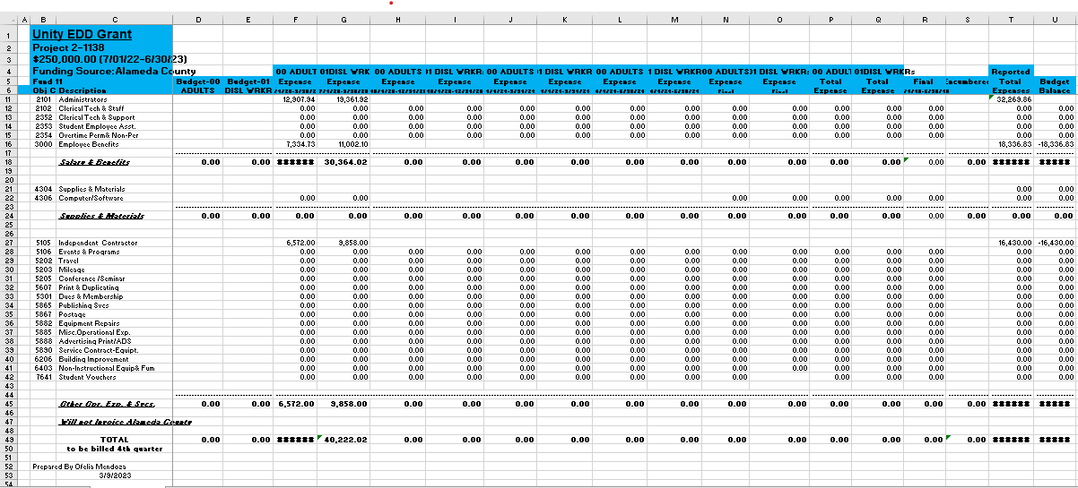
Worksheet of Expenditures

Slide 8
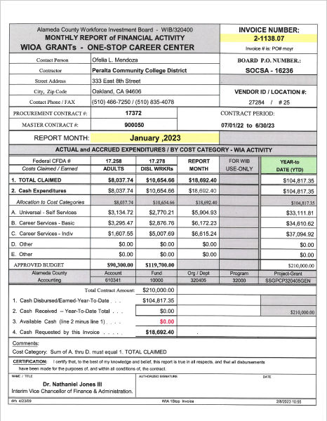
Invoice / Reimbursement

Slide 9
Quarterly Reporting Categorical
Presenters:
Adil Ahmed, Associate Vice Chancellor of Finance and Administration

Slide 10
Quarterly Reporting Categorical
Demo
Login In: https://fm.peralta.edu/
How to run a report.

Slide 11
Fund 11 Project - Budget vs Actuals

Slide 12
Questions?

Slide 13
Leave Banking
Presenter:
Adil Ahmed, Associate Vice Chancellor of Finance and Administration

Slide 14
Leave Banking
Important Points:
Leave Banking is related to Full-Time Faculty positions.
Full-Time Faculty positions are allowed to work overload.
Overload teaching refers to faculty members teaching academic courses over and above their regular course assignments.
When a Faculty person is doing overload, they can bank the overload portion of their compensation for payment in the future.

Slide 15
Leave Banking
To efficiently and properly manage the Leave Banking program, any overload the Faculty member wants to bank (not pay in the current fiscal year), the VPIS of each college needs to submit a report listing the faculty member(s) banking the hours.

Slide 16
Leave Banking
Procedure:
VPIS develops list of faculty members banking their leave.
Use the list to calculate the amount of leave banking to record.
VPAS records the general journal for the amount of the banked leave.

Slide 17
Leave Banking
Sample of general journal to record:
DR Salary & Benefit Expense $ X,XXX.XX
CR Payroll Liability (Balance Sheet A/C 9518) $(X,XXX.XX)

Slide 18
Leave Banking
By following this process, it helps Finance to accurately verify the requested amount for the Leave Banking Payout.

Slide 19
Questions?

Slide 20
Enrollment Revenues
Presenters: ​
Joyce Brown-Willis, Systems Analyst – Student Financial Applications​
Adil Ahmed, Associate Vice Chancellor of Finance and Administration

Slide 21

Enrollment Revenues
Enrollment Fee Revenue Report:
Enrollment fee revenue for fees charged. Fee revenue includes fees paid and receivables for courses beginning after the close of the prior year spring term through the close of the current year spring term.

Slide 22
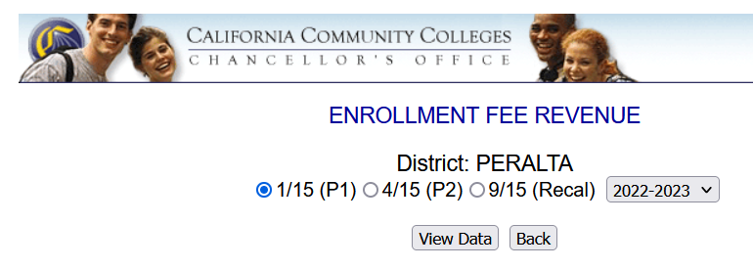
Enrollment Revenues
This report is due three times a year :
January 15th P1 (Estimate 1)
April 15th P2 (Estimate 2)
September 15th Recal (Final Report for the year)

Slide 23
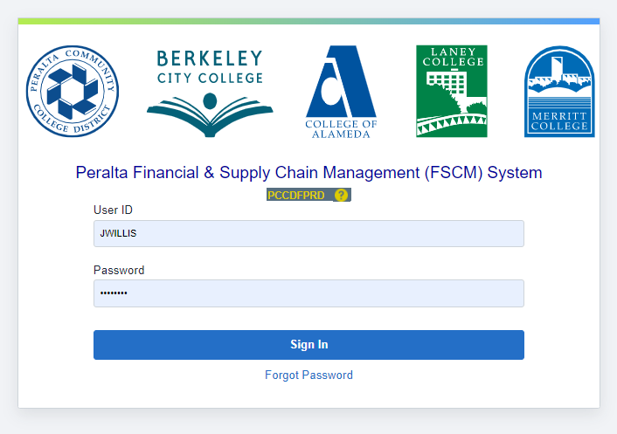
Enrollment Revenues
Data for the report is retrieved from the Financial & Supply Chain Management System (FCSM) in PeopleSoft.

Slide 24
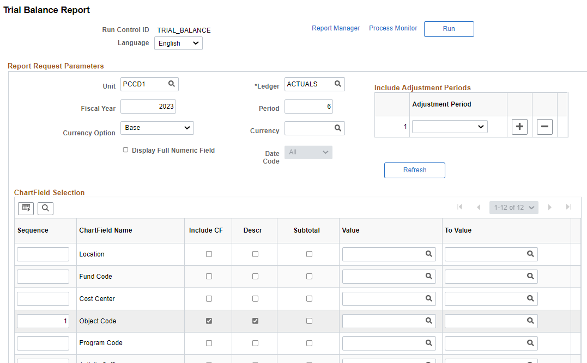
Enrollment Revenues
The Trial Balance Report is ran to retrieve the data.
8874 8874

Slide 25
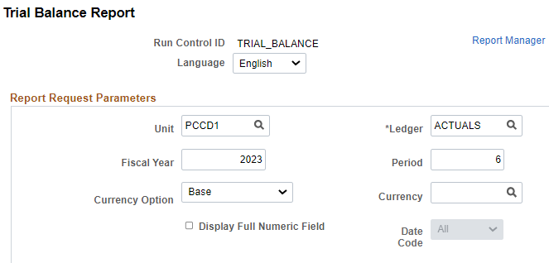
Enrollment Revenues
There are three “Periods” to be ran based on the time of year the report is generated.
DUE DATES | PERIOD
January 15th | 6
April 15th | 9
September 15th | 12
Notes:
MONTH
PERIOD
July = 1
August = 2
September = 3
October = 4
November = 5
December = 6
January = 7
February = 8
March = 9
April = 10 (July 1st – March 31^{st)}
May = 11
June = 12

Slide 26
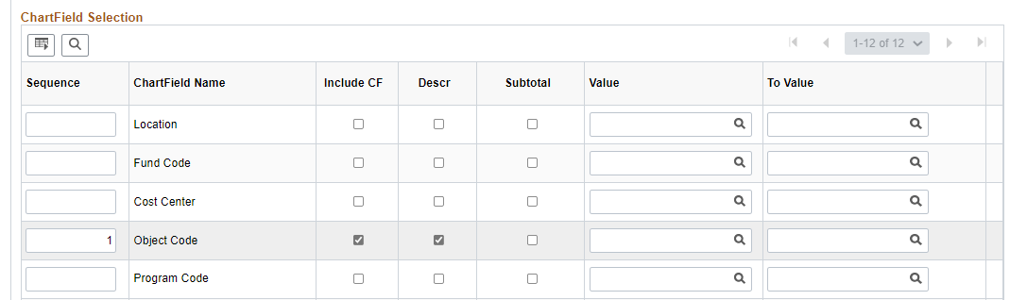
Enrollment Revenues
The Trial Balance Report is ran showing only Object Code #8874 which will show the charge fields and descriptions for the fiscal year.
8874 8874
8874 8874

Slide 27
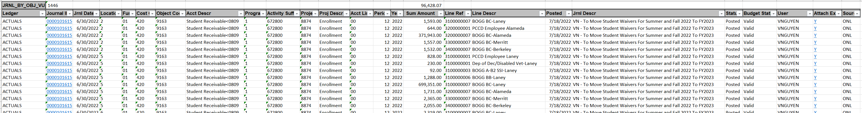
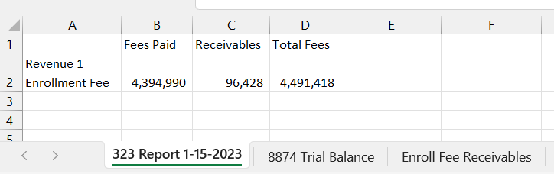
Enrollment Revenues
The data us downloaded into an excel spreadsheet.

Slide 28
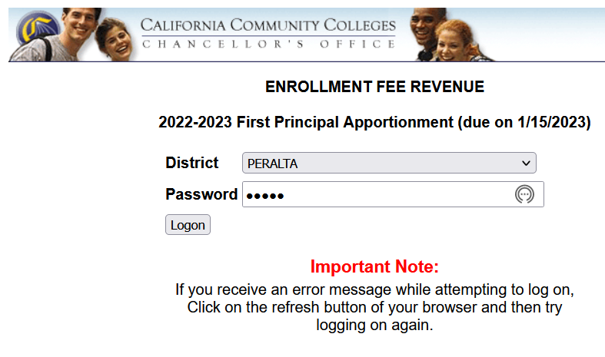
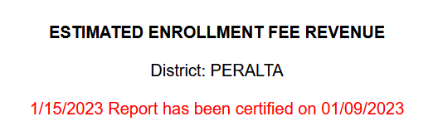
Enrollment Revenues
After the data is retrieved from PeopleSoft, Student Finance logs into the California Community Colleges Reporting Portal to enter PCCD’s fiscal and budgetary data to the Chancellor’s Office.
Notes:
https://misweb02.cccco.edu/enrollmentfee/prod/logon.cfm - Password is 89776

Slide 29
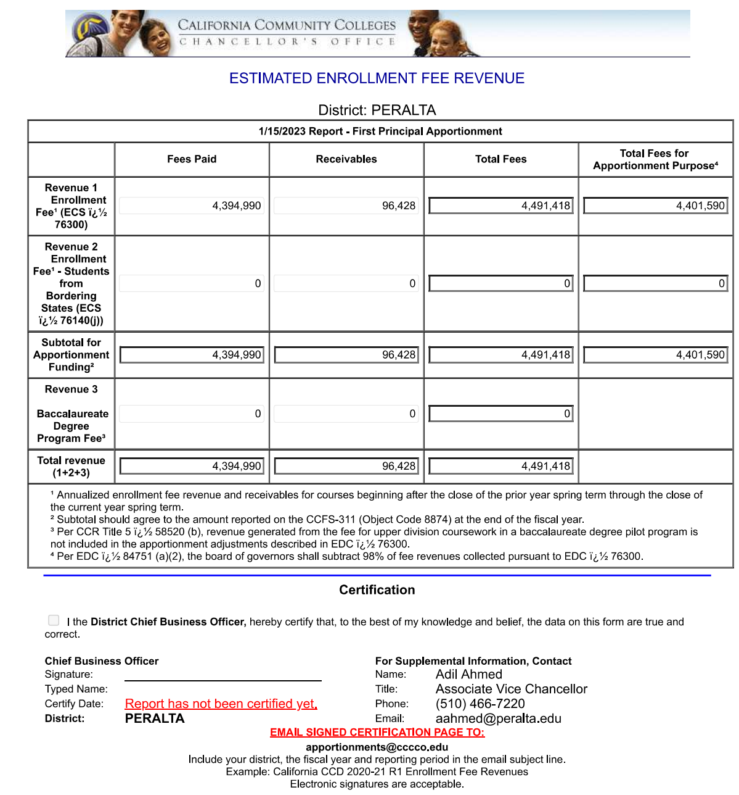
Enrollment Revenues
Notes:
https://misweb02.cccco.edu/enrollmentfee/prod/logon.cfm - Password is 89776

Slide 30
Enrollment Revenues
The data is then entered into the portal.

Slide 31
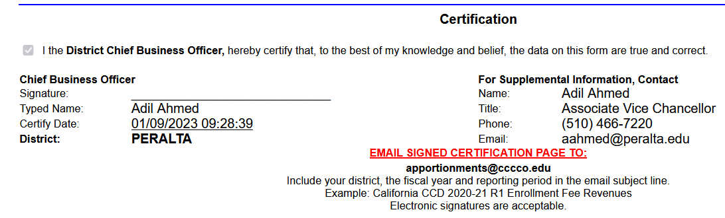
Enrollment Revenues
After which, it is certified by the Chief Business Officer of Finance at PCCD.

Slide 32
Questions?

Slide 33
50% Law
Presenter:
Adil Ahmed, Associate Vice Chancellor of Finance and Administration

Slide 34
50% Law
The Fifty Percent Law requires all community college districts to spend at least half of their “Current Expense of Education” for “Salaries of Classroom Instructors.” Education Code Section 84362 and the implementing regulations in the California Code of Regulations title 5, section 59200, et. al., provide for exemptions under certain circumstances.
All districts reporting deficiencies on the Fifty Percent Law report in the CCFS-311 Annual Financial and Budget Report in a given fiscal year will be reported in the following Board of Governors March meeting agenda item on the Fifty Percent Law, whether or not an application for exemption is filed. If a district spent less than fifty percent of the Current Expense of Education for the Salaries of Classroom Instructors and wishes to be given consideration for an exemption, the district governing board must file an application for exemption and the subsequent related local governing board findings.
COVID-19 Expenditures are exempt from the fifty percent law computation through June 30, 2021. Education Code section 84363 allows for a two-year exclusion of any expenditures incurred during a state or local declared emergency related to the COVID-19 pandemic that are not otherwise normal expenditures that would have been incurred.

Slide 35
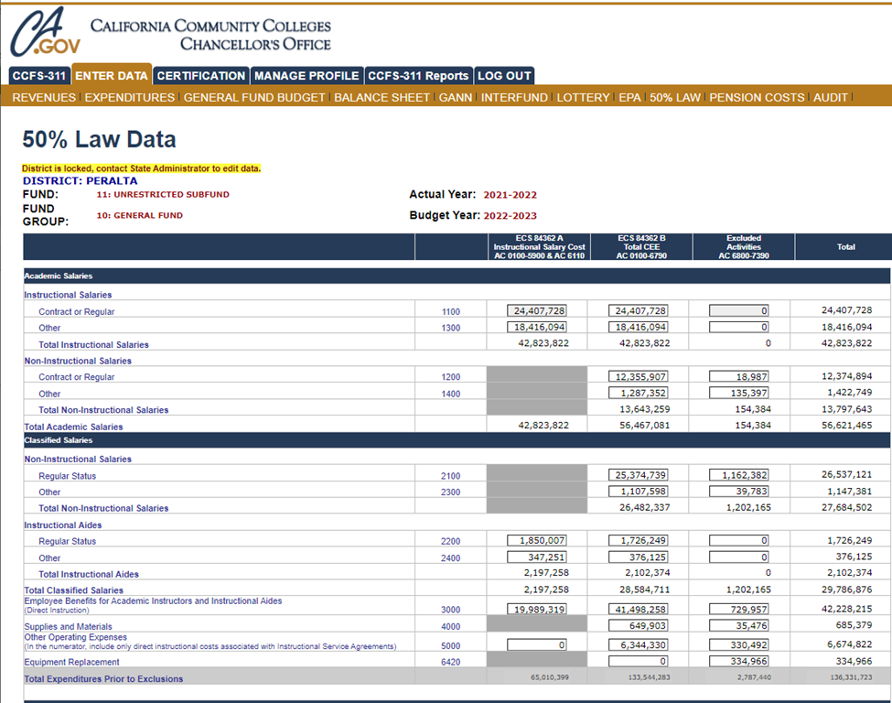
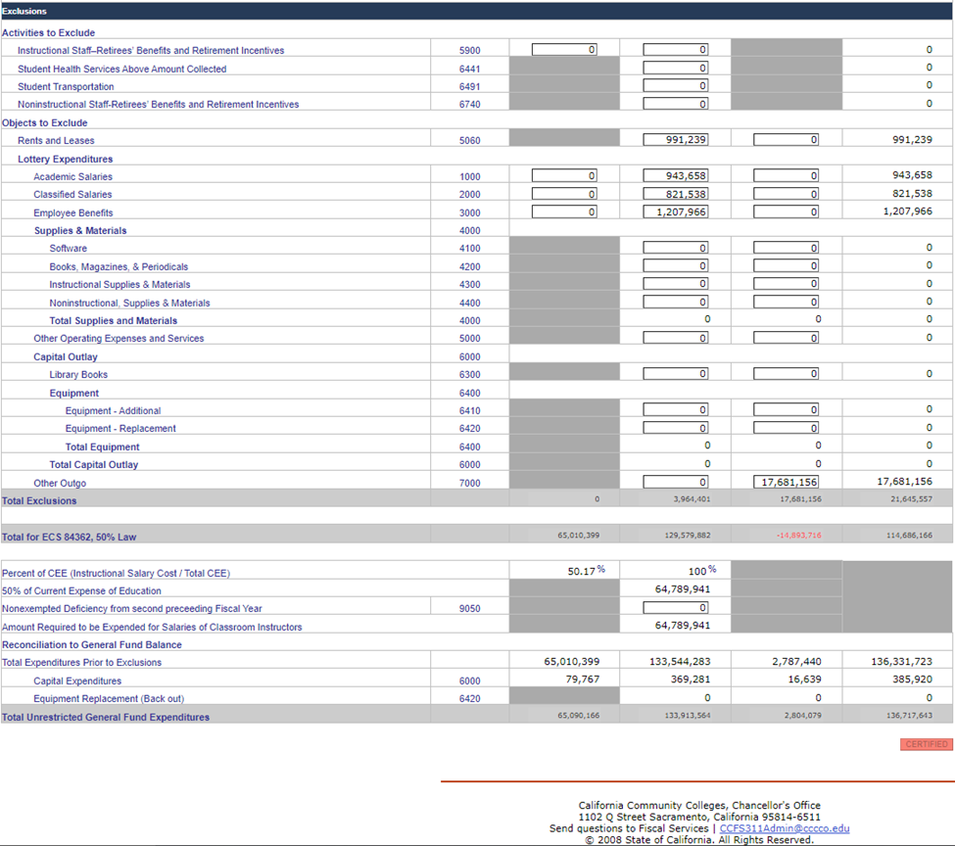
50% Law – State Chancellors Office

Slide 36
Questions?

Slide 37
Student Receivables
Presenter:
Adil Ahmed, Associate Vice Chancellor of Finance and Administration

Slide 38
Student Receivables
Student Receivables is an item on the balance sheet of PCCD audited financial statements.
It is represented in object code 9163.
It represents the fees that the students owe to PCCD for enrollment in classes.

Slide 39
Student Receivables
Student Enrollment fees include the following:
Enrollment
AC Transit EasyPass
Campus Center Use
Student Representation
Capital Outlay
Health
International Student Health Insurance
Non-Resident Tuition
Parking
NSF (Non-Sufficient Funds)

Slide 40
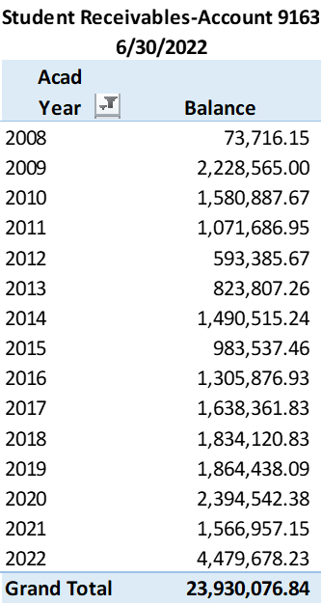
Student Receivables
As a part of year end close, the Student Receivables subsidiary ledger is run by the Student Financial Systems Analyst for review and calculation of the Bad Debt Allowance.

Slide 41
Student Receivables
As part of the Board and Administrative policy and as with all organizations, the amount of receivable that is considered uncollectible will be determined. This leads to the calculation of Bad Debt Allowance.

Slide 42
Questions?

Slide 43
Bad Debt Calculation – Student Receivables
Presenters:
Tami Taylor, Senior Accountant
Adil Ahmed, Associate Vice Chancellor of Finance and Administration

Slide 44
Bad Debt Calculation – Student Receivables
Explanation: Percentage amount of Student Receivables that will be recorded as uncollectable on our annual audited financial statements.
The transaction is recorded at the end of the fiscal year and before completion of the audit.

Slide 45
Bad Debt Calculation – Student Receivables
Calculation of the Bad Debt Allowance is determined by board and administrative policy.
    BP 6302 (Draft)
    AP 6302 (Draft)
Bad Debt Allowance is a contra account to Student Accounts Receivable account. Other names for this item are:
    Allowance for Uncollectable
    Allowance for Bad Debt

Slide 46
Bad Debt Calculation – Student Receivables
It is represented in object code 9164.
It is a transaction that is recorded at the end of each fiscal year and before completion of the audit.
The transaction is recorded as follows:
DR – Expense Account (Statement of Net Position)
CR – Allowance for Bad Debt (Balance Sheet)

Slide 47
Bad Debt Calculation – Student Receivables
Procedures to determine amount to record:
The Student Financial Systems Analyst runs the Student Subsidiary Ledger report listing all students and their outstanding fee balance owed to PCCD.

Slide 48
Bad Debt Calculation – Student Receivables
Using the procedure guidelines from AP6302 (Draft), the bad debt allowance is calculated as follows:
The calculation of the Allowance shall be made annually and shall be calculated as follows:
  20% of the receivables over one year
  40% of the receivables over two years
  60% of the receivables over three years
  80% of the receivables over four years
  100% of the receivables over five years

Slide 49
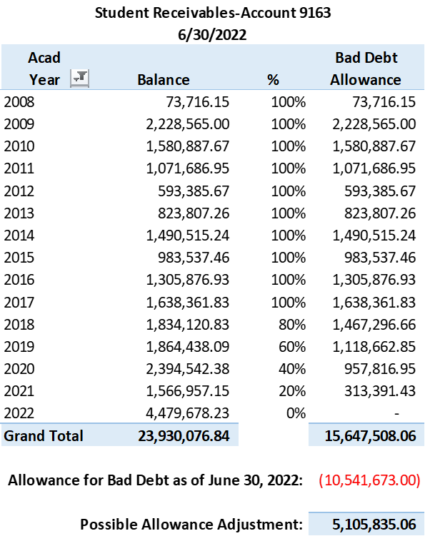
Bad Debt Calculation – Student Receivables
Once the calculation is completed, a business decision needs to be made by the management team on whether to record the complete amount or partial amount based on the financial condition of PCCD for each year. Since this is an estimation, we do not want to show a deficit at year end.

Slide 50
Bad Debt Calculation – Student Receivables
After a review on the effect to PCCD financial condition, the final estimated amount is recorded in a general ledger journal as follows:
DR – Expense Account (1-01-141-5899-1-672000-0000-00)
CR – Allowance for Bad Debt (1-01-420-9164-1-672800-0000-00)

Slide 51
Questions?

Slide 52
Gann Limit
Presenter:
Adil Ahmed, Associate Vice Chancellor of Finance & Administration

Slide 53
Gann Limit
Information on the appropriations limit established by Proposition 4 (1979), also known as the Gann limit.
What is the appropriations limit?
The appropriations limit calculated under Government Code 7902, often referred to as the Gann limit, was established by Proposition 4 in 1979. Simply put, the purpose of the limit is to keep inflation adjusted per-person government spending under 1978–79 levels. For Local Education Agencies (LEAs), Average Daily Attendance (ADA) is used to determine population.
While the appropriations limit does function as a limit on LEA spending, Government Code 7902.1(a) allows LEAs with proceeds of taxes in excess of their appropriation limit (e.g., LEAs who need additional limit) to request additional limit from the State of California. This request is automatically approved.
This has recently changed, and LEAs are no longer required to request additional Gann Limit beyond the State Apportionment due to property tax revenue.

Slide 54

Gann Limit
Information on the appropriations limit established by Proposition 4 (1979), also known as the Gann limit.
https://www.cde.ca.gov/fg/ac/gl/

Slide 55
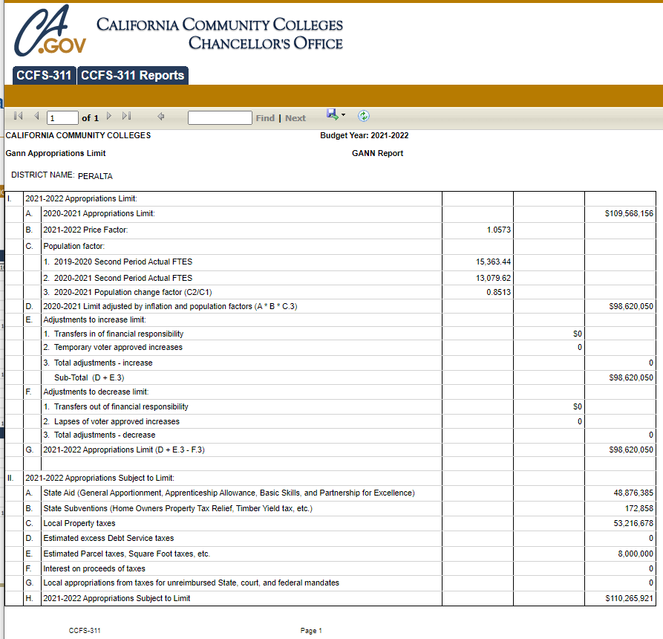
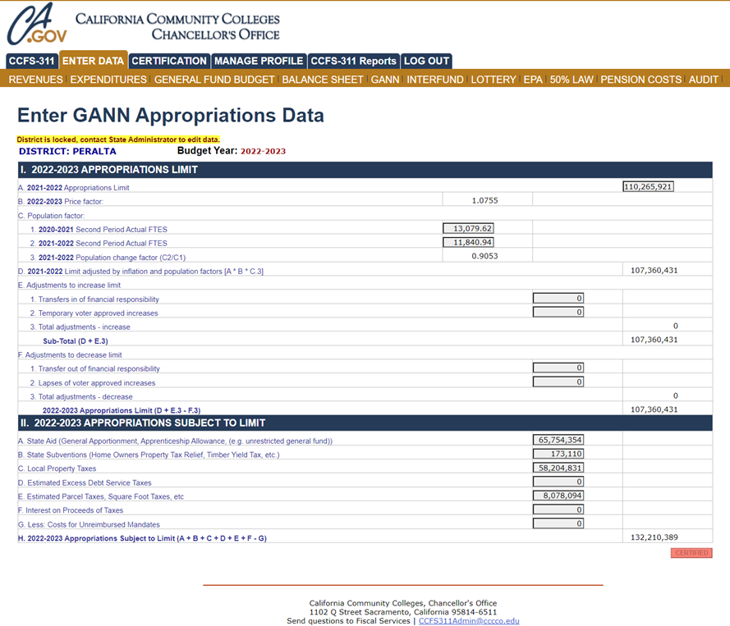
Gann Limit
Gann limit information loaded to the State
The price factor comes from the State

Slide 56
Questions?

Slide 57



Thank You!
@PeraltaColleges
@PeraltaColleges
@peraltacolleges

