Slide 1
Peralta Community College District
Student Insurance Plan Overview
2021-2022

Slide 2
Health Insurance Basics
Welcome to the Peralta Community College Student Insurance Plan!
Why is health insurance important?
The U.S. does not offer free medical care to the general public and medical care is expensive!
Average cost of emergency room visit nationwide – $2,168
Typical ambulance ride – $600 - $1,200
Average cost of doctor visit – $105
Doctor’s fees, lab charges, X-rays, surgery, etc. all cost extra $$$
You are required to have insurance while at Peralta CC.

Slide 3
Common Definitions
Plan Maximum- The largest total amount your plan will pay per person, per plan year.
Deductible - The amount you owe for healthcare services, before the health insurance begins to pay.
Covered percentage/coinsurance - Your share of the costs of a covered health care service(s), calculated as a percentage.
Physician Office Visit Copay - A fixed amount you pay for a covered health service, at the time of your visit
Out-of-Pocket Maximum - The most you pay during a policy period, before your insurance pays 100% of the allowed amount (this cost includes copays, deductibles, and coinsurance amounts).

Slide 4
Coverage Details (Treatment Must be Medically Necessary)
Benefits include:
$250,000 maximum benefit per injury or sickness
Most physician visits and hospital charges, paid at 100% (after copay) for Aetna Passport services; or 80% of URC (after deductible) for out-of-network services
Specific emergency benefit expenses
Surgery, in- and outpatient
Tests, procedures, and lab services, such as X-rays
Physical therapy, acupuncture and chiropractic care
Maternity and prenatal care
Prescription drugs
Detailed benefits can be found in the plan materials posted on the Peralta microsites at www.4studenthealth.com.

Slide 5
How to Enroll
You are automatically enrolled through your school; no action is needed to enroll yourself in the plan.
To enroll your dependents online, visit www.4studenthealth.com. Select your campus and plan, and click “View Your Plan”
Your dependents (spouse, domestic partner, or children under the age of 26), must be enrolled before the start of the term or within 31 days of marriage, birth, adoption, or arrival in the U.S
For questions about enrollment, contact Relation at (800) 537-1777.

Slide 6
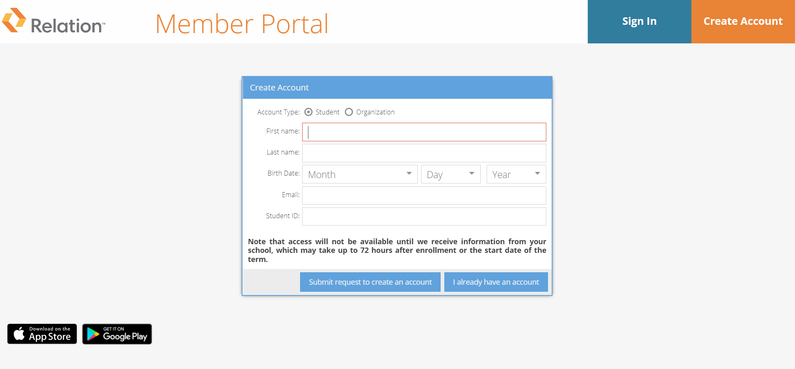
Insurance ID Card
Once you are enrolled in the plan, you will receive an email notifying you that your ID card is available. Log in or create an account at www.4studenthealth.com.
If you need medical treatment before you receive notice that your ID card is active, please contact Relation at (800) 537-1777. Always carry your insurance ID card with you.

Slide 7
How to Use Your Insurance Plan
Your Insurance plan utilizes a PPO Network.
“PPO” or “in-network” means that the doctor or medical facility is part of the Preferred Provider Organization, a network of doctors and hospitals that have contractually agreed to provide services at a lower rate.
If you use an Aetna Passport provider, covered medical services are paid by the insurance company at 100% of the Preferred Allowance.
Non-PPO (aka out-of-network)
“Non-PPO” or “out-of-network” means that the doctor or facility has not agreed to a lower rate, resulting in more expensive care.
Since these providers charge more, the insurance company will only pay a fraction of the cost. This results in you paying more money out of your pocket.
If you use an out-of-network provider, covered medical expenses are paid at 80% of Usual, Reasonable, and Customary (URC) charges.

Slide 8
Finding a PPO Medical Provider
While insured under this plan, your medical PPO network is Aetna Passport to Healthcare® Primary PPO.
To find an Aetna Passport provider:
Visit www.aetna.com/docfind/custom/passport.
Enter your location and range, then click “Search.”
Select the Passport to Healthcare® Primary PPO, then click “Continue.”
Type the name, specialty, or type of provider you’re looking for into the search bar, or click the corresponding category.
Select a provider from the list, and call to make an appointment
It is best to locate an Aetna Passport doctor, urgent care center, and emergency room near you before you get sick. Always verify the provider is part of the Aetna Passport to Healthcare® Primary PPO Network before you receive treatment.

Slide 9
Getting a Medication
Fill your prescriptions at an Express Scripts pharmacy, which may include CVS, Walgreens, and Walmart. To locate a pharmacy, visit www.express-scripts.com or call (800) 400-0136.
Or visit www.4studenthealth.com and choose your campus where you will be redirected to the Express Scripts website to create a student account for access to the pharmacy directory.
Always ask for the generic form of the drug, if available; this will decrease the cost.
If you do not use an Express Scripts pharmacy, you will need to pay in full and then send a claim for reimbursement.

Slide 10
What You Will Pay
Deductibles and copays are not included in what the insurance pays. As such, you will be responsible for paying the following in addition to the premium:
A $20 copay when you go to an Aetna Passport physician’s office
A $20 copay when you go to an Aetna Passport urgent care center
A $250 copay/deductible if you go to an Aetna Passport emergency room (waived if admitted)
A $50 copay if you go to an Aetna Passport hospital
20% coinsurance if you do not use an Aetna provider
Expenses in excess of Usual, Reasonable, and Customary (URC) charges if you do not use an Aetna Passport provider
Full amount for any services not covered by insurance (see exclusions and limitations in the Plan Summary

Slide 11
COVID-19 Coverage
This insurance plan will cover medically necessary, prescribed diagnostic testing for COVD-19. This coverage includes:
Cost sharing is waived for medically necessary COVID-19 testing
Symptoms must be present and testing must be ordered by a licensed physician
COVID-19 treatment is covered at the same coverage levels as other covered benefits (i.e. network, coinsurance and copays may apply).
NOT covered: COVID-19 testing for travel (such as an entry requirement for a country), to allow entry to school grounds or a workplace, trace testing, testing for non-symptomatic individuals or any other reason that is not related to the health of the policyholder.

Slide 12
Supplemental Options
Protect yourself and your family members with affordable supplemental coverage
Access a range of coverage options, including dental and vision at www.4studenthealth.com/supplemental-plans.
These plans should only be purchased in addition to the student insurance plan, not in lieu of it.
Individual Dental and Vision Insurance Plans - designed to encourage preventive treatment, allowing you to achieve optimal oral/vision health while striving to minimize costs.
HMO and PPO plans available
Each plan is sold on an individual basis and plan may not be available in every location

Slide 13
Campus Health Center
Visit the campus health center first before receiving any treatment off campus. If you receive a referral to be seen by an outside provider, keep the signed Referral Form until you are ready to submit your claim.
Campus Specific Resources:
Berkeley City College: https://www.berkeleycitycollege.edu/wellness-center/
College of Alameda: https://alameda.edu/students/health-wellness-services/
Laney College: https://alameda.edu/students/health-wellness-services/
Merritt College: https://www.merritt.edu/health/

Slide 14
How To Access Care
DialCare Telemedicine and Mental Wellness
Designed to provide a safe, secure, and private means of seeking assistance via virtual or telephonic sessions from the convenience of your home.
Telemedicine consultations can assist with cold and flu, rashes, allergies, minor injuries, and more.
Mental Wellness health professionals can assist with depression, anxiety, stress, grief, relationship problems, and more.
App-based interface with easy-to-access professionals.
To register download the DialCare app from the Apple or Google Play app stores, visit www.dialcare.com, or call (855)-335-2255 to put your plan in the palm of your hand.

Slide 15
How To Access Care
Physician Office Visit / Other Medical Services
For in-person visits for non-urgent, minor medical concerns, schedule an appointment with a provider.
When calling to schedule an appointment, ask the doctor or medical facility to confirm that they are still a participating Aetna Passport to Healthcare® Primary PPO Network provider
Note: this is different from asking if they accept Aetna insurance.
Urgent Care Center (UCC)
When you need treatment for a severe but non-life-threatening condition and you cannot wait for a scheduled appointment go to a UCC. Some examples of conditions UCCs can assist with are:
Sprains
Fever / Chills
UCCs are much more affordable than ERs and usually have much shorter wait times.

Slide 16
How To Access Care
Hospital / Emergent Care (ER)
When there is an immediate threat to your life or health call 911 for an ambulance or go to the nearest hospital emergency room (ER). Some examples of an emergency are:
Loss of consciousness
Broken bones or excessive bleeding
Sudden and severe pain
If you access an ER for non-emergencies be prepared for the following:
There is a $250 copay if you are not admitted
Long wait times: triage is used to decide who is most urgently in need of medical care
Higher costs: ERs charge much more than doctor’s offices and urgent care centers
No coverage for ER expenses for minor conditions - you will pay out of your own pocket

Slide 17
How Claims Are Paid
After you receive treatment at a PPO provider, your provider will usually submit a claim to the insurance company.
You will receive an Explanation of Benefits from ACI, detailing what the insurance paid and what is your responsibility to pay. This is not a bill, only an indication of what you may be responsible for paying.
If you have questions about your Explanation of Benefits or what is your responsibility to pay, please call (800) 483-6192.
The doctor will receive payment from the insurance company and then bill you for any amount not covered by the insurance company.
Do not ignore any medical bills you receive.
If you have questions about claims, contact ACI at (800) 476-4802 or claims@visit-aci.com. To review your claims online, visit the Claims Member Portal at https://secure.visit-aci.com/ClaimStatus/.

Slide 18
How Claims Are Paid
If the medical provider does not file a claim on your behalf, you will need to submit a claim for reimbursement. Follow these steps:
Download a claim form and fill it out completely.
Claim forms are available at www.4studenthealth.com, choose your school, then under Claims in the USE YOUR INSURANCE section.
Include your member number (as shown on your ID card) on the claim form.
Attach itemized bills for X-rays, lab charges, etc.
Send your claim form and all bills pertaining to this claim to ACI at the address below. Try to have all itemized bills attached to the same claim form.
Administrative Concepts, Inc.
PO Box 4000 Collegeville
Pennsylvania 19426
Fax: (610) 293-9299
Always keep copies of all documents you submit.

Slide 19
Treatment Throughout the U.S. and Abroad
Coverage is worldwide, paid at the plan’s coinsurance levels after any copays or deductibles. Certain exclusions and limitations may apply.
However, any treatment, services, or supplies incurred or received in your Home Country are not covered.
Submit all medical bills, receipts, and other information to the claims department address.

Slide 20
Recap
In an emergency call 911 or head to the closest ER! In all other instances, visit your Campus Health Center whenever possible, use DialCare for telehealth, schedule an appointment with a doctor, or go to an Urgent Care Center.
For medical services, you don’t have to go to an Aetna provider, but you will save money if you do. Once you find a provider, we recommend that you confirm that they are in-network before you schedule an appointment.
For prescription services, go to an Express Scripts pharmacy when possible.
If you have questions regarding eligibility, enrollment, or plan materials call Relation at (800) 537-1777 or visit the www.4studenthealth.com.
If you have claims questions call ACI at (800) 476-4802 or claims@visit-aci.com.

Slide 21
Telephone: (800) 537-1777
Email: clientservices@relationinsurance.com
Berkeley City College.......................www.4studenthealth.com/Berkeley
College of Alameda .........................www.4studenthealth.com/alameda
Laney College ................................. www.4studenthealth.com/laney
Merritt College ................................ www.4studenthealth.com/merritt

