Slide 1
WHAT IT MEANS TO BE ON THE LANEY COLLEGE
CURRICULUM COMMITTEE
LANEY COLLEGE 9.3.2021

Slide 2
Outline
10+1
Terminology/Acronyms
State Chancellor’s Office
Curriculum Committee Function/Roles
Process of Approval
CIPD
Standards & Criteria
Course Outline of Record (COR)
Updating, Repeatability, Uniform Course Numbering (UCN), Types of Course Appropriate to the Assoc. Degree
Consultation
Distance Education (DE)
Non-Credit
Planning Ahead
Credit for Prior Learning (CPL)
Call to Action for Equity

Slide 3
Faculty Authority Over Curriculum
3
Authority over the curriculum is codified in California Education Code (§70902) and further refined in title 5 Regulations (§53200).
Along with the authority, there is a responsibility: work with other faculty, administrators, and staff.
Administration has “right of assignment” over courses and programs.

Slide 4
Curriculum is a “10 + 1” Matter
4
Curriculum, including establishing prerequisites and placing courses within disciplines.
Degree and certificate requirements.
Grading policies.
Educational program development.
Standards or policies regarding student preparation and success
The rest of them are less Curriculum oriented.
Notes:
4

Slide 5
Types of Curriculum-clean this one up. Abit confusing
5
CREDIT
Courses
Degree-applicable
Non degree-applicable
Programs
Associate Degrees (AA, AS)
Associate Degrees for Transfer (AA-T, AS-T)
Certificates of Achievement
      16 + units must be submitted to CO
      8-<16 units may be submitted to CO
Locally Approved Certificates
    <8 units; or 8 -<16 units not CO approved
NONCREDIT
Courses
Noncredit: Courses must fit in one of 10 categories to be approved by CO/receive apportionment
Vs. Not-for-credit/Community Services: fee-supported class; apportionment is not claimed; locally approved
Programs
Cert. of Completion/Competency (CDCP)
Adult High School Diploma
Noncredit Apprenticeship Program
Locally Approved Certificates (not CO approved)

Slide 6
Terminology –
Board of Trustees (BOT)
  Local governing board – decision makers
  Board of Governors (BOG) - state
Council on Instruction, Planning and Development
  We have Uniform Course Numbering (UCN)
    All BIOL 10 courses have to have the same catalog information (exception: grading {grades or pass/no pass} can vary)
    Changes to catalog information has to be agreed upon
    CIC – other colleges use for their committees – we use CC

Slide 7
Terminology – State Terms
“The State” – they give us control numbers
  After BOT approves, we send course/program to state for approval
  New Courses/Programs need control numbers
    Each course has it’s own control number
      BIOL 10 at BCC, COA, Merritt & Laney have different #s
    Illegal to offer a class with out a control number
    Need to advertise for 30 days before you offer it

Slide 8
Terminology – ALL those Acronyms
5C – California Community College Curriculum Committee
ASCCC—Academic Senate for California Community Colleges
CCCCO—California Community Colleges Chancellor’s Office
CIO—Chief Instructional Officer (often the VPI)
COCI—Chancellor’s Office Curriculum Inventory
COR—Course Outline of Record
CPL----Credit for Prior Learning
PCAH—Program and Course Approval Handbook
PPCAH or PCAPM – Peralta PCAH
GP – Guided Pathways
Other acronyms:
.

Slide 9
Terminology – Transfer/Articulation
  Transferable: minimum credit/units (electives)
  UC reviews CCC CORs annually to see if they meet UC policy guidelines.
  CSU (E.O. 167) relies on local curriculum committees to determine transferability. Their executive order outlines their guidelines.
  Articulation: lower-division courses for G.E. and/or Major Preparation
  4-yr Discipline Faculty review (ASSIST.org) for seamless transfer
  TMC - Transfer Model Curriculum (SB1440)
  State (CCCCO.edu) has list of TMC templates, reviewed every 5 yrs by FDRGs(Faculty Discipline Review Groups), feedback during vetting period
  C-ID – California Identification Numbering System
  C-ID Articulation (SB1415) is a course numbering system to ease transfer and articulation
  CCC CORs approved by Course Reviewers (CCC & CSU discipline faculty)
  Course Descriptors are reviewed every 5 yrs by FDRGs

Slide 10
California Community College Chancellor’s Office
The mission of the California Community Colleges Board of Governors and the Chancellor's Office is to empower the community colleges through leadership, advocacy and support.

Slide 11
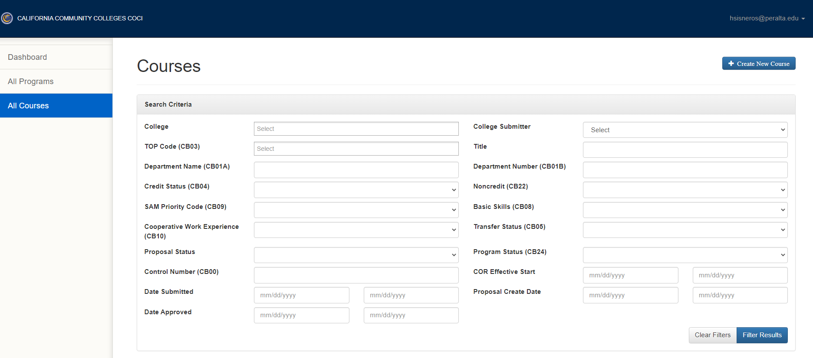
Chancellor’s Office Curriculum Inventory (COCI)
https://coci2.ccctechcenter.org/

Slide 12
Streamlining Local
Curriculum Processes
As the Chancellor’s Office continues to streamline curriculum processes, it is highly recommended that colleges review their local processes for streamlining benefits as well.
  How many steps are in your local approval process (i.e., the workflow from origination to Governing Board approval)? (Chat Box)
Streamlining = reduction, rearrangement, and/or addition of steps to local processes.
Annual Curriculum Training to ensure compliance with the annual certification.
Notes:
SHIREEN

Slide 13
Noncredit Course and Program Approvals in 2021
STOP: Needs CO Approval before chaptering:
  All CDCP certificate programs in the domain of short-term vocational (includes new and modified and includes new and modified apprenticeship)
GO: Does NOT need CO approval before chaptering:
  CDCP certificates in the domains of ESL, Workforce Preparation, and Elementary & Secondary Basic Skills (new and modified)
  AHSD - Adult High School Diploma Programs (new and modified)
  All noncredit courses (new and modified)

Slide 14

Vision for Success and Core Commitments – opening general session
Vision for Success
Increase credential obtainment by 20%
Increase transfer by 35% to UC and CSU
Decrease unit obtainment for a degree
Increase employment for CTE students
Reduce and erase equity gaps
Reduce regional gaps
Core Commitments
Focus on students’ goals
Design and decide with the student in mind
Pair high expectations and high support
Evidence-based decisions
Own student performance
Enable innovation and action
Cross-system partnership

Slide 15
Our Function
As a standing committee of the Laney College Faculty Senate, the Curriculum Committee is responsible for the review and approval of curriculum.
  After Curriculum Committee approval, curriculum requests move through the Vice President of Instruction, the Council of Instructional Planning and Development (CIPD) and the Board of Trustees.

Slide 16
Our Responsibilities
Review proposals for new courses and programs, course and program revisions and deactivations.
Participate in the program review and accreditation review processes.
Review and recommend changes in the general education and graduation requirements.
Review course proposals for alignment with articulation requirements.
Recommend procedures and policies affecting curriculum.
Review and recommend changes to the college catalog.

Slide 17
Process for Approval
Local College Approval
  Varies by campus
Council on Instruction, Planning and Development
  New courses and programs
  Changes to existing courses and programs
Board of Trustees
  All courses & programs that to CIPD
  DE added to a course
State Chancellors Office
  Course – gets a code
  Programs – gets final approval

Slide 18
Ex: Laney College Process
Originator
Department Chair
Technical Review
Step Three – all at the same time
  Articulation Officer
  Librarian
  SLO Coordinator
Back to Originator at any point if there are requested changes to be made
  Course/program will go back to you to review the comments, make changes, etc.
Curriculum Committee
  Might ask you questions or ask you to make additional changes.

Slide 19
What is CIPD?
Role of CIPD
Voting Members (by college)
To advise the district in academic areas and related planning
To provide a leadership role in program development
To review college curriculum additions, deletions, or modifications
  submit them to the Chancellor and subsequently to the Board of Trustees for approval.
College Curriculum Committee Chair
Articulation Officer
Faculty Senate appointee
Vice President of Instruction
One other college administrator
  VP of Student Services or a Division Dean
Vice Chancellor of Educational Services chairs the committee
  has one vote in case of a tie
Ex-officio Members are:
  PFT President
  District Academic Senate President

Slide 20
What Goes to CIPD?
CIPD - YES
CIPD - NO
Anything that changes the catalog!
  Department name and/or abbreviation
  Course number
  Course title
  Course description
  Pre/co-requisite, including recommended preparation
  Hours for lecture and/or laboratory
  Grading basis
DE Addendum
  Info only
Substantive Changes
  Changes that are not reflected in the catalog, but need to be sent to state (the Codes)
Only needs college curriculum committee approval if..
Fee Based Courses
Doesn’t change catalog
  Textbook Updates
  Modifying lecture/lab content
  Updating objectives
  Updating SLOs

Slide 21
55002 - Standards and Criteria
(a) Degree-Applicable Credit Course.
  A degree-applicable credit course is a course which has been designated as appropriate to the associate degree in accordance with the requirements of section 55062, and which has been recommended by the college and/or district curriculum committee and approved by the district governing board as a collegiate course meeting the needs of the students.

Slide 22
55002 - Standards and Criteria
(1) Curriculum Committee
  The college and/or district curriculum committee recommending the course shall be established by the mutual agreement of the college and/or district administration and the academic senate.
  The committee shall be either a committee of the academic senate or a committee that includes faculty and is otherwise comprised in a way that is mutually agreeable to the college and/or district administration and the academic senate.

Slide 23
55002 - Standards and Criteria
(2) Standards for Approval.
    The college and/or district curriculum committee shall recommend approval of the course for associate degree credit if it meets the following standards:
This is where we get the information for our course outlines
  https://govt.westlaw.com/calregs/Document/I83E8E9A0B6CB11DFB199EEE3FF08959C?viewType=FullText&originationContext=documenttoc&transitionType=CategoryPageItem&contextData=(sc.Default)

Slide 24
What are the Development Criteria?
Local curriculum approval assures that each proposal meets five criteria:
  Appropriateness to Mission
  Need
  Curriculum Standards
  Adequate Resources
  Compliance

Slide 25
Credit COR Structure as Required by Title 5 §55002-
Unit value (credit courses)
Total contact hours for course (more on this later...)
Outside of class hours
Total student learning hours
Conditions of enrollment: requisites, advisories, and other conditions
Catalog description
Objectives
(more on SLOs later...)
Content (typically in outline form)
Reading and Writing Assignments or others as appropriate
Other outside-of-class assignments
Methods of instruction
(more on DE later...)
Methods of evaluation / grading policy
Notes:
Stephanie

Slide 26
Noncredit COR Structure as Required by Title 5 §55002
Total contact hours for course (can be a range)
Catalog description
Objectives
Content (typically in outline form)
Assignments and activities
Methods of instruction
Methods of evaluation / grading policy
Notes:
Lisa

Slide 27
Course Outline of Record (COR)
Legal document of what we are teaching
Has to be available to public
  Students can ask for a copy
Needs to be current for Articulation to CSU/UC
Available to Everyone via CurrIQunet META
  There is a public search option on our website

Slide 28
55003 – Frequency of Updating
(a) The governing board of a community college district may establish prerequisites, corequisites, and advisories on recommended preparation, but must do so in accordance with the provisions of this article. Nothing in this subchapter shall be construed to require a district to establish prerequisites, corequisites, or advisories on recommended preparation; provided however, that a prerequisite or corequisite shall be required if the course is to be offered for associate degree credit and the curriculum committee finds that the prerequisite or corequisite is necessary pursuant to sections 55002(a)(2)(D) or 55002(a)(2)(E). Unless otherwise specified in this section, the level of scrutiny required to establish prerequisites, corequisites, and advisories on recommended preparation shall be based on content review as defined in subdivision (c) of section 55000 or content review with statistical validation as defined in subdivision (f) of this section. Determinations about prerequisites and corequisites shall be made on a course-by-course or program-by-program basis.

Slide 29
55003 – Frequency of Updating
(b) A district governing board choosing to establish prerequisites, corequisites, or advisories on recommended preparation shall, in accordance with the provisions of sections 53200-53204, adopt policies for the following:
  (4) the process, including levels of scrutiny, for reviewing prerequisites and corequisites to assure that they remain necessary and appropriate. These processes shall provide that at least once each six years all prerequisites and corequisites established by the district shall be reviewed, except that prerequisites and corequisites for vocational courses or programs shall be reviewed every two years. These processes shall also provide for the periodic review of advisories on recommended preparation.

Slide 30
What does 55003 mean?
Courses with pre-requisites and/or co-requisites for transfer need to be reviewed/updated every 6 years
Courses with pre-requisites and/or co-requisites that are CTE need to be reviewed/updated every 2 years
DE Addendum is required to be reviewed every 6 years
ADD LANEY POLICY: review all curriculum every 4 years (every 2 years for CTE), and must update curriculum every 4 years.

Slide 31
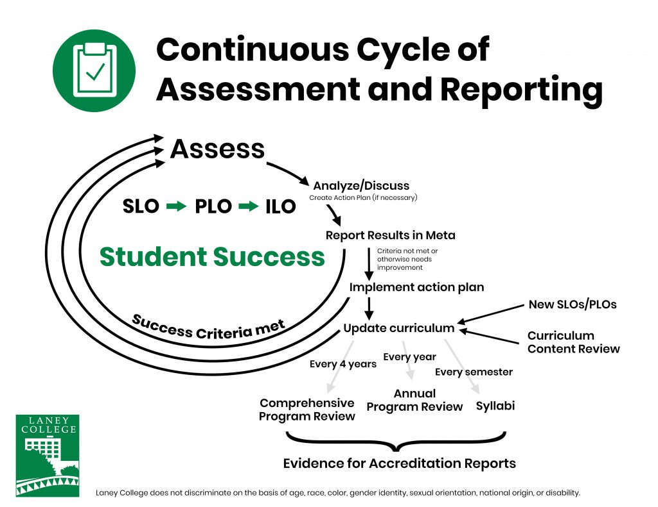
Use Outcomes to Update Outline

Slide 32
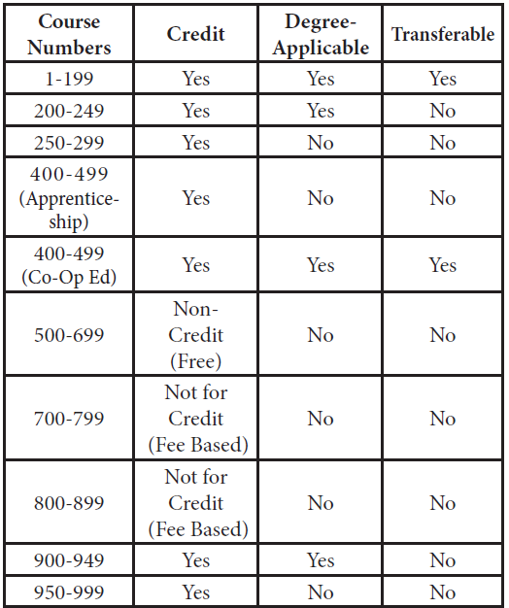
Uniform Course Numbering System

Slide 33
55062 - Types of Courses Appropriate to the Associate Degree
The criteria established by the governing board of a community college district to implement its philosophy on the associate degree shall permit only courses that conform to the standards specified in section 55002(a) and that fall into the following categories to be offered as degree-applicable credit courses:
  (a) All lower division courses accepted toward the baccalaureate degree by the California State University or University of California or designed to be offered for transfer.
  (b) Courses that apply to the major or area of emphasis in non-baccalaureate career technical fields.
(c) English composition or reading courses not more than one level below the first transfer level course. Each student may count only one such course below transfer level for credit toward the associate degree, except that reading courses which also satisfy the requirements of subdivision (a) are not subject to this limit. English as a Second Language (ESL) courses which teach composition or reading skills are not considered to be English composition or reading courses for purposes of this subdivision.
(d) All mathematics courses above and including Elementary Algebra.
(e) Credit courses in English and mathematics taught in or on behalf of other departments and which, as determined by the local governing board require entrance skills at a level equivalent to those necessary for the courses specified in subdivisions (c) and (d) above.

Slide 34
Consultation Guidelines/Requirements
Consultation of courses/programs among Colleges is necessary to ensure:
Program Integrity
Appropriate use of district resources
Program delivery to students in convenient locations
Adequate enrollment in all programs at all colleges
Curriculum taught at more than one college has identical information per Uniform Course Numbering (UCN) policy requirements/state mandates
There is no unnecessary overlap of curriculum across the district

Slide 35
Consultation is required if…
Requesting to clone a course from another campus, (cloning course assumptions: cloner will not change any items that would affect catalog or be a substantial change)
Developing a new course
Reactivating a course
Updating any items in the list below to an existing course (basically, anything catalog or substantive.
Subject (Discipline) | Units | CB21 Levels Below Transfer
Course Number | Hours | CB24 Program Course Status
Title | CB12 Repeatability | Override Outside Class Hours
Description | CB03 TOP Code | Outside Class Hours
Modular Course | CB04 Course Credit Status Code | Out of Class Assignments
Open Entry | CB08 Basic Skills Code | Requisites
Cross-listed Courses | CB09 Sam Code | CB22 Non-Credit Category
 | CB25 Course GE Status | CB26 Course Support Course Status

Slide 36
55200 – Distance Education
Distance education means instruction in which the instructor and student are separated by time and/or distance and interact through the assistance of technology.
  In addition , instruction provided as distance education is subject to the requirements that may be imposed by the Americans with Disability Act (42 U.S.C. 12100 et seq.) and section 508 of the Rehabilitation Act of 1973, as amended, (29 U.S.C. 794d)
55206 – separate vote
  On addendum
  Update with accreditation – every 6 years

Slide 37
Noncredit: A Tool in Your Toolbelt
Goal: Develop curriculum based on identifying the needs of students.
  Not just a progression from noncredit to credit. Many credit students take noncredit classes
Students may need more than 16-18 weeks to learn new skill
  Original Competency Based Learning program
  Time is the variable until mastery is achieved
  Students can have repeated enrollment in course.
  Progress is measured, P, SP, NP

Slide 38
You can’t just rename a credit course noncredit
(and you’ve tried…)
Categories: English as a Second Language, Immigrant Education, Elementary and Secondary Basic Skills, Health and Safety, Substantial Disabilities, Parenting, Home Economics, Courses for Older Adults, Short-Term Vocational, and Workforce Preparation.
Career Development and College Preparation (CDCP) programs have enhanced funding in four disciplines (above). Programs must be comprised of at least two courses.
Certificate of Competency: ESL, Elementary and Secondary Basic Skills
Certificate of Completion: Short-Term Vocational, Workforce Prep
Dodging the repeatability issue
Positive Attendance Accounting needs to be captured

Slide 39
Planning Ahead
Plan a year in advance
  Comprehensive Program Review Year is a good time to look ahead
Ensure you have enough time for your goal
  If your goal is Fall 2022, it should be in submitted for approval now
Check CIPD website for dates
Make sure you are leaving enough time for approval process

Slide 40
Credit for Prior Learning (CPL)
Credit for prior learning is college credit awarded for validated college-level skills and knowledge gained outside of a college classroom.
Students’ knowledge and skills might be gained through experiences such as:
  Military training
  Industry training
  State/federal government training
  Volunteer and civic activities
  Apprenticeships, internships, work-based learning, or other industry-based experiential learning
CPL is not awarded for knowledge and skills already assessed and awarded credit through formal education at regionally accredited in-state and out-of-state institutions.

Slide 41
Credit for Prior Learning (CPL)
The CPL policy is designed to increase degree and certificate completion, close equity gaps, and meet California’s projected workforce demands. Research indicates that students who earn CPL:
  are roughly twice as likely to complete a degree than those who do not;
  accumulate more credits through coursework at the institution than their counterparts, which translates to increased enrollment for colleges;
  save an average of 6-10 months in time to degree compared to their non-CPL counterparts.
This policy reform encourages districts and colleges to provide students more consistent and equitable access to prior learning assessments, to promote quality, integrity and equity in the award of credit, and make programs more accessible to millions of students without certificates or degrees.

