Slide 1
WHAT IT MEANS TO BE ON THE LANEY COLLEGE CURRICULUM COMMITTEE
LANEY COLLEGE 8.23.2019

Slide 2
Outline
Terminology
Course Outline of Record
Local Committee
Our Function
Our Responsibilities
Our Processes
State Chancellor’s Office

Slide 3
Terminology –
Board of Trustees (BOT)
Local governing board – decision makers
Board of Governors (BOG) - state
Council on Instruction, Planning and Development
We have Uniform Course Numbering (UCN)
All BIOL 10 courses have to have the same catalog information
Changes to catalog information has to be agreed upon
CIC – other colleges use for their committees

Slide 4
Terminology – State Terms
“The State” – they give us control numbers
After BOT approves, we send course/program to state for approval
New Courses/Programs need control numbers
Each course has it’s own control number
BIOL 10 at BCC, COA, Merritt & Laney have different #s
Illegal to offer a class with out a control number
Need to advertise for 30 days before you offer it
State and their approval review:
New Courses 1-499 not reviewed, just give control number
CE Courses, Non-Credit Courses – get reviewed by state
All Programs reviewed by state
Working on Non-Credit being streamlined

Slide 5
Terminology – Transfer Stuff
Terms
Matriculate – process of entering college
Transfer – can count as an elective at a 4 year
Articulate – can replace a similar course at a 4 year
TMC - Transfer Model Curriculum (SB1440)
State has list of TMCs with templates
C-ID – California Identification Numbering System
C-ID is a supranumbering system being developed to ease transfer and articulation in California’s higher education institutions.
Currently, C-ID has 368 approved descriptors and 33 draft descriptors from over 81 different disciplines.

Slide 6
Course Outline of Record (COR)
Why update?
How often?

Slide 7
Course Outline of Record (COR)
Legal document of what we are teaching
Has to be available to public
Students can ask for a copy
Needs to be current for Articulation to CSU/UC
Available to Everyone via CurrIQunet META
There is a public search option on our website

Slide 8
55002 - Standards and Criteria
(a) Degree-Applicable Credit Course.
A degree-applicable credit course is a course which has been designated as appropriate to the associate degree in accordance with the requirements of section 55062, and which has been recommended by the college and/or district curriculum committee and approved by the district governing board as a collegiate course meeting the needs of the students.

Slide 9
55002 - Standards and Criteria
(1) Curriculum Committee
The college and/or district curriculum committee recommending the course shall be established by the mutual agreement of the college and/or district administration and the academic senate.
The committee shall be either a committee of the academic senate or a committee that includes faculty and is otherwise comprised in a way that is mutually agreeable to the college and/or district administration and the academic senate.

Slide 10
55002 - Standards and Criteria
(2) Standards for Approval.
The college and/or district curriculum committee shall recommend approval of the course for associate degree credit if it meets the following standards:
This is where we get the information for our course outlines
https://govt.westlaw.com/calregs/Document/I83E8E9A0B6CB11DFB199EEE3FF08959C?viewType=FullText&originationContext=documenttoc&transitionType=CategoryPageItem&contextData=(sc.Default)

Slide 11
What does the COR have to include?
Basics for Catalog
Title, Course Number, Date, Hours, Grading Policy
Description, Pre-req/Co-reqs if any
Transfer Status
Textbooks
Can list more than one (choices)
Need to be current unless historical (literature)
Course Objectives
Course Content that relates to objectives
Need percentage of time spent on topics
Need detail for Articulation
Student Learning Outcomes
Required for all courses and programs
55002 part a, section 3 - COR
Notes:
A-G list the different areas
A- Grading Policy; B – Units, C- Intensity, D – Pre-req/Co-req, E – Basic Skills, F- Difficulty, G- Level

Slide 12
55062 - Types of Courses Appropriate to the Associate Degree
The criteria established by the governing board of a community college district to implement its philosophy on the associate degree shall permit only courses that conform to the standards specified in section 55002(a) and that fall into the following categories to be offered as degree-applicable credit courses:
(a) All lower division courses accepted toward the baccalaureate degree by the California State University or University of California or designed to be offered for transfer.
(b) Courses that apply to the major or area of emphasis in non-baccalaureate career technical fields.
(c) English composition or reading courses not more than one level below the first transfer level course. Each student may count only one such course below transfer level for credit toward the associate degree, except that reading courses which also satisfy the requirements of subdivision (a) are not subject to this limit. English as a Second Language (ESL) courses which teach composition or reading skills are not considered to be English composition or reading courses for purposes of this subdivision.
(d) All mathematics courses above and including Elementary Algebra.
(e) Credit courses in English and mathematics taught in or on behalf of other departments and which, as determined by the local governing board require entrance skills at a level equivalent to those necessary for the courses specified in subdivisions (c) and (d) above.

Slide 13
55003 – Frequency of Updating
(a) The governing board of a community college district may establish prerequisites, corequisites, and advisories on recommended preparation, but must do so in accordance with the provisions of this article. Nothing in this subchapter shall be construed to require a district to establish prerequisites, corequisites, or advisories on recommended preparation; provided however, that a prerequisite or corequisite shall be required if the course is to be offered for associate degree credit and the curriculum committee finds that the prerequisite or corequisite is necessary pursuant to sections 55002(a)(2)(D) or 55002(a)(2)(E). Unless otherwise specified in this section, the level of scrutiny required to establish prerequisites, corequisites, and advisories on recommended preparation shall be based on content review as defined in subdivision (c) of section 55000 or content review with statistical validation as defined in subdivision (f) of this section. Determinations about prerequisites and corequisites shall be made on a course-by-course or program-by-program basis.

Slide 14
55003 – Frequency of Updating
(b) A district governing board choosing to establish prerequisites, corequisites, or advisories on recommended preparation shall, in accordance with the provisions of sections 53200-53204, adopt policies for the following:
(4) the process, including levels of scrutiny, for reviewing prerequisites and corequisites to assure that they remain necessary and appropriate. These processes shall provide that at least once each six years all prerequisites and corequisites established by the district shall be reviewed, except that prerequisites and corequisites for vocational courses or programs shall be reviewed every two years. These processes shall also provide for the periodic review of advisories on recommended preparation.

Slide 15
What does 55003 mean?
Courses with pre-requisites and/or co-requisites for transfer need to be reviewed/updated every 6 years
Courses with pre-requisites and/or co-requisites that are CTE need to be reviewed/updated every 2 years
But wait, what about if it has a DE Addendum?

Slide 16
55200 – Distance Education
Distance education means instruction in which the instructor and student are separated by distance and interact through the assistance of communication technology.
All distance education is subject to the general requirements of this chapter as well as the specific requirements of this article.
In addition , instruction provided as distance education is subject to the requirements that may be imposed by the Americans with Disability Act (42 U.S.C. 12100 et seq.) and section 508 of the Rehabilitation Act of 1973, as amended, (29 U.S.C. 794d)
55206 – separate vote
On addendum
Update with accreditation – every 6 years

Slide 17
Repeatability – 55040 Student
Allows for repetition due to extenuating circumstances
Occupational work experience (55253)
Legally mandated training
Significant change in industry standard
Student with a disability can repeat a special class for students with disabilities
Active participatory courses
Family limitations for physical education, visual arts or performing arts
Student can only take 4 courses out of a family

Slide 18
Repeatability – 55041 Course
Repeatable types of Courses
Meets Major Requirement of CSU or UC
Intercollegiate Athletics (related conditioning courses) - (58162)
Intercollegiate Academic or Vocational competition
A class designed for competition overseen by an outside body

Slide 19
Local Curriculum Committee
Our Function
Our Responsibilities

Slide 20
Our Function
As a standing committee of the Laney College Faculty Senate, the curriculum committee is responsible for the review and approval of curriculum.
After Curriculum Committee approval, curriculum requests move through the Vice President of Instruction, the Council of Instructional Planning and Development (CIPD) and the Board of Trustees.

Slide 21
Our Responsibilities
Review proposals for new courses and programs, course and program revisions and deactivations.
Participate in the program review and accreditation review processes.
Review and recommend changes in the general education and graduation requirements.
Review course proposals for alignment with articulation requirements.
Recommend procedures and policies affecting curriculum.
Review and recommend changes to the college catalog.

Slide 22
Curriculum Approval Process
Planning, Procedures, Process

Slide 23
Process for Approval
Local College Approval
Varies by campus
Council on Instruction, Planning and Development
New courses and programs
Changes to existing courses and programs
Board of Trustees
All courses & programs that to CIPD
DE added to a course
State Chancellors Office
Course – gets a code
Programs – gets final approval

Slide 24
Ex: Laney College Process
Originator
Department Chair
Technical Review
Step Three – all at the same time
Articulation Officer
Librarian
SLO Coordinator
Back to Originator at any point if there are requested changes to be made
Course/program will go back to you to review the comments, make changes, etc.
Curriculum Committee
Might ask you questions or ask you to make additional changes.

Slide 25
What is CIPD?
Role of CIPD
Voting Members (by college)
To advise the district in academic areas and related planning
To provide a leadership role in program development
To review college curriculum additions, deletions, or modifications
submit them to the Chancellor and subsequently to the Board of Trustees for approval.
College Curriculum Committee Chair
Articulation Officer
Faculty Senate appointee
Vice President of Instruction
One other college administrator
VP of Student Services or a Division Dean
Vice Chancellor of Educational Services chairs the committee
has one vote in case of a tie
Ex-officio Members are:
PFT President
District Academic Senate President

Slide 26
What Goes to CIPD?
CIPD - YES
CIPD - NO
Anything that changes the catalog!
Department name and/or abbreviation
Course number
Course title
Course description
Pre/co-requisite, including recommended preparation
Hours for lecture and/or laboratory
Grading basis
DE Addendum
Info only
Substantive Changes
Changes that are not reflected in the catalog, but need to be sent to state (the Codes)
Only needs college curriculum committee approval if..
Fee Based Courses
Doesn’t change catalog
Textbook Updates
Modifying lecture/lab content
Updating objectives
Updating SLOs

Slide 27
Consultation is required if…
Requesting to clone a course from another campus, (cloning course assumptions: cloner will not change any items that would affect catalog or be a substantial change)
Developing a new course
Reactivating a course
Updating any items in the list below to an existing course
Below is a list of changes to a course that requires consultation.
Subject (Discipline) | Units | CB21 Levels Below Transfer
Course Number | Hours | CB24 Program Course Status
Title | CB12 Repeatability | Override Outside Class Hours
Description | CB03 TOP Code | Outside Class Hours
Modular Course | CB04 Course Credit Status Code | Out of Class Assignments
Open Entry | CB08 Basic Skills Code | Requisites
Cross-listed Courses | CB09 Sam Code | CB22 Non-Credit Category
 | CB25 Course GE Status | CB26 Course Support Course Status

Slide 28
Uniform Course Numbering System
001 – 199
Courses numbered 1-199 are designated as baccalaureate level, degree applicable courses for transfer to institutions within the California State University and the University of California Systems, including Selected Topics for liberal arts and vocational disciplines (48s)
200 – 249 and 900-949
Courses numbered 200-249 And 900-949 are degree applicable, but are not transferable to institutions within the California State University and the University of California Systems, including Selected Topics for liberal arts and vocational disciplines (248s)
250 – 299 and 950-999
Courses numbered 250-299 And 950-999 are not degree applicable, and are not transferable to institutions within the California State University and the University of California Systems.

Slide 29
Uniform Course Numbering System
300-399 (Currently not used)
400 – 499
Apprenticeship and Cooperative Education courses are numbered 400-499. Credit Apprenticeship course are not degree applicable, and are not transferable to institutions within the California State University and the University of California Systems, while Cooperative Education courses are degree applicable and transferable to institutions within the California State University and the University of California Systems
500 – 699
Non-credit courses (Zero unit)
700 – 799 (Currently not used)
800 – 899
Course numbered 800- 899 are Community Services (fee-based) courses that offered for no (zero) units and for which students pay fees to cover the cost of instruction. These classes are not listed in the schedule of classes

Slide 30
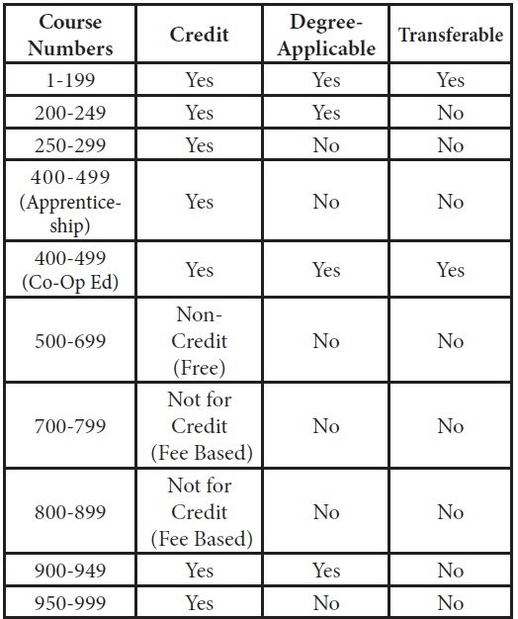
Uniform Course Numbering System

Slide 31
Consultation Guidelines/Requirements
Consultation of courses/programs among Colleges is necessary to ensure:
Program Integrity
Appropriate use of district resources
Program delivery to students in convenient locations
Adequate enrollment in all programs at all colleges
Curriculum taught at more than one college has identical information per Uniform Course Numbering (UCN) policy requirements/state mandates
There is no unnecessary overlap of curriculum across the district

Slide 32
Consultation Guidelines/Requirements
The Faculty Originator must contact department chair at all affected disciplines and colleges to begin the consultation process. This email should have the Consultation Form filled out and attached to it.
Consultation discussions should be finalized, (whether agree or disagree with the consult) within 4-6 weeks of initial contact.
Preliminary responses to consultation requests must occur within 2 weeks of initial contact. If there is no response in the 2-week timeframe, then curriculum may move to local agenda.
After engagement in the consultation process, faculty at other campuses may agree to the curriculum request or disagree to the request, at which those reasons should be stated on the Consultation Form.
Consultation does not mean agreement. It is designed for communication between colleges/disciplines as a professional courtesy and demonstration of respect.
If there are unresolved disputes or disapproval of the curriculum request, the issues will be discussed and resolved at CIPD. (Either tabling the course to request more information, or voting to approve/oppose curriculum.)

Slide 33
Planning Ahead
Plan a year in advance
Comprehensive Program Review Year is a good time to look ahead
Ensure you have enough time for your goal
If your goal is Fall 2020, it should be in submitted for approval now
Check CIPD website for dates
Make sure you are leaving enough time for approval process

Slide 34
Use Outcomes to Update Outline

Slide 35
STATE CHANCELLOR’S OFFICE
Who are they?

Slide 36
California Community College Chancellor’s Office
The mission of the California Community Colleges Board of Governors and the Chancellor's Office is to empower the community colleges through leadership, advocacy and support.

Slide 37
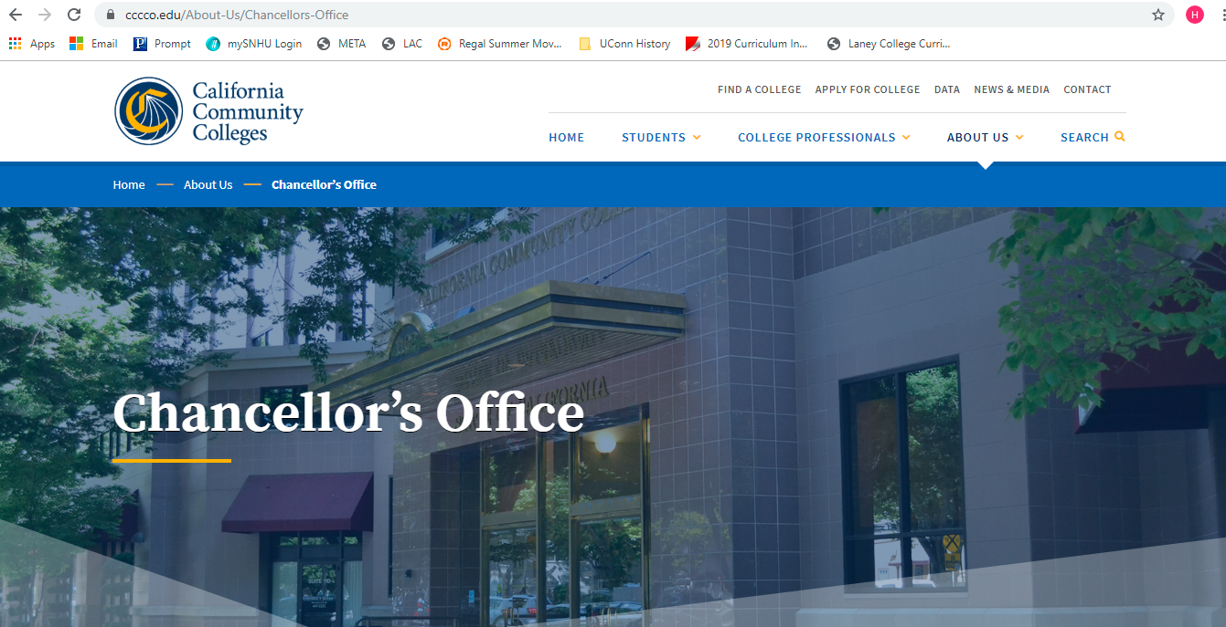
State Chancellor’s Office

Slide 38
CCCCO Curriculum Inventory
curriculum.cccco.edu/search

