Slide 1

Guided Pathways
A Berkeley City College
Student Success Initiative
2018

Slide 2
What is Guided Pathways
The Guided Pathway (GP) framework creates a highly structured approach to student success.
    Provides all students with set of clear course taking patterns that promotes better enrollment decisions and prepares students for success.
    Integrates support services in ways that make it easier for students to get the help they need during every step of their CC experience.

Slide 3
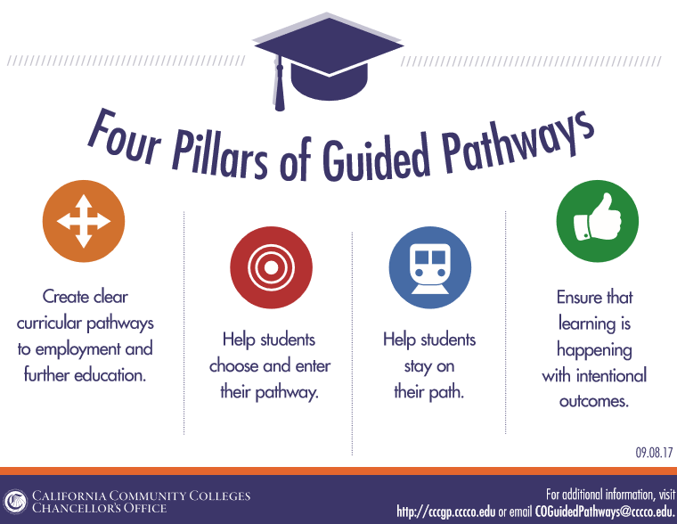
Four Pillars of GP

Slide 4
6 Key Elements of GP
Programs are fully mapped out and aligned for degree completion, transfer, or job attainment while also providing structured/guided exploration for undecided students.
Proactive academic and career advising from the start through completion and/or transfer with assigned point of contact at each college.
Early alert systems to be aligned with interventions and resources to help students stay on the pathway, persist, and progress.

Slide 5
6 Key Elements of GP
(continued…)
Redesigning and integrating basic skills/developmental education classes to accelerate students to college-level classes.
Structured onboarding process including improved placement tests and co-requisite instruction that provide students with clear, actionable, and usable information they need to get to the right start in college.
Instructional support and co-curricular activities aligned with classroom learning and career interests.

Slide 6
What are the benefits of GP for Students?
Less confusion and more clarity about the steps toward completion and course-taking patterns and behavior.
More guidance from counseling or advisory early in students’ journeys
Improved chances for transfer, degree obtainment, and career placement due to:
    Efficient time to completion
    Fewer unnecessary credits

Slide 7
Who are our students?
Berkeley City College Enrollment Trend
Source: Datamart
Notes:
This is BCC’s annual snapshot of our student enrollment trends.
Census = number of annual course enrollment
Headcount = count of unique students
We have a strong head count…but lower FTES due to high part time rate.
Guided Pathways will help us determine optimum sections based on student needs.
Between FY17 and FY15, our headcount, sections, and FTEF drop by 1%. In effect, our census (# of sections enrolled) dropped 6% and FTES dropped 4%.
Data Source: Datamart

Slide 8
Who are our students?
SPRING 2018
BCC ENROLLMENT STATUS
Source: BI TOOL
Notes:
High part-time rate impacts the rate students complete degrees or transfer.
A benefits of analyzing student needs is that we can determine the gaps in schedule and other non-academic reasons why students may not be taking 12 credits or more.
Another benefit is that regardless of status, students have an identified pathway .

Slide 9
Who are our students?
SPRING 2018
BCC STUDENT AGE GROUP
BIGGEST AGE GROUP: 19-24 YEARS OLD
Source: BI TOOL
Notes:
Over half of our students are still the traditional college age students but Guided Pathways strategies (course offering that support working adults, early alert and intrusive counseling to identify challenges and resources early) for non-traditional learners will have positive impact on their educational experiences and success.

Slide 10
Who are our students?
SPRING 2018
BCC STUDENT ETHNIC GROUP
Diverse
Student Body
Source: BI TOOL
Notes:
Guided Pathways will support BCC’s work in closing the success gaps.

Slide 11
Who are our students?
CTE
44.8%
Overall completion of 8 CTE units & completed a degree, certificate, apprenticeship or transfer (2010-11 through 2015-16)
SKILL BUILDER
+13.1%
The median percentage change in wages for students who completed higher level CTE coursework in 2013-2014 and left the system without receiving a degree, certificate, or transfer.
TOP 10
EDUCATIONAL GOALS
SPRING 2018
Source: BI TOOL, SPRING 2018
Source: 2017 STUDENT SUCCESS SCORECARD
Notes:
Guided Pathways creates a highly structured academic maps and student support to meet our students’ goals.

Slide 12
Academic Performance
COURSE SUCCESS (Completing a class with a passing grade)
DEGREE/TRANSFER COMPLETION (By Cohort)
Source: 2017 STUDENT SUCCESS SCORECARD
Percentage of degree, certificate and/or transfer-seeking students starting first time in 2010-11 tracked for six years through 2015-16 who completed a degree, certificate or transfer-related outcomes.
Notes:
By aligning the strategies already present in our integrated plan, additional data analysis and tracking, and adopting structured academic pathways and support, our students will experience high degree and transfer completion.

Slide 13
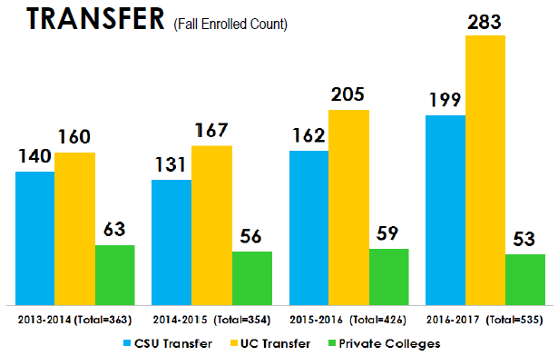
Academic Performance
TRANSFER LEVEL ACHIEVEMENT
(2014-15 First Time Students)
TRANSFER TRENDS
Source: 2017 STUDENT SUCCESS SCORECARD
The percent of first-time students in 2014-15 who complete 6 units and attempt any Math or English in their first year who complete a transfer-level course in Math or English in their first or second year with a passing grade.
Notes:
Source: BCC Scorecard

Slide 14
Academic Performance
BASIC SKILLS
(2010-11 Cohort starting below transfer level and completing college level courses by 2015-16)
PERSISTENCE
(By cohort during first 3-consecutive terms)
Source: 2017 STUDENT SUCCESS SCORECARD
Percentage of credit students tracked for six years through 2015-16 who first enrolled in a course below transfer level in English, mathematics, and/or ESL during 2010-11 and completed a college-level course in the same discipline.
Notes:
Guide Pathways strategies that BCC is already deploying like English sequence, multiple measures will help students decrease the time to get from below transfer level to college level course completion.

Slide 15

Think of it like a GPS System or Navigation App for completion
GPS | Guided Pathways
Fastest way to get to a destination | Fastest way to degree completion or transfer
Can’t drive on the freeway? Choose your route | Customized educational plan based on identified course sequences
Turn by turn navigation | Describes all the requirements needed – no wrong course selection
Warns of traffic ahead and identifies new routes | Services and programs support students’ needs and challenges to maintain retention and persistence
Calculates your estimated time of arrival | Scheduled courses ensure students can complete within a reasonable time frame

Slide 16
Bringing it home!
Guided Pathways At Berkeley City College

Slide 17
Brief Background
2017-2018 is the first year (except those in the pilot programs) for CCC’s to start planning for the implementation of the GP
State of California has committed $150M one-time investment for 5 years for all 114 colleges as the seed money for the GP implementation.
Colleges are expected to rethink and redesign program and services into cohesive, campus-wide strategies to achieve student success.
Goal of GP is to help students succeed in achieving their educational and career goals and eliminating achievement gaps.

Slide 18
2017-2018 BCC Tasks at Hand
What’s been done so far at BCC?
2016-2017
* Guided Pathway pilot program preparation began
* District Academic Senate was on board
* Work group was created (Chair of the chair, Deans, VPI, interim VPSS), not cross-functional yet.
Summer 2017
* State announced the commitment of $150 M for 5 years to 114
colleges
Fall 2017
* Preparation for the self-assessment, beginning of conversation
* IEPI workshop participation, shared with the college what they learned
* Completion and submission of BCC Self-Assessment to the State

Slide 19
Result of Self-assessment
 |  | Scale of Adoption
Key Element |  | Pre-Adoption | Early Adoption | In Progress | Full Scale
Inquiry | 1. Cross-Functional Inquiry |  | X
 | 2. Shared Metrics |  | X
 | 3. Integrated Planning |  | X
Design | 4. Inclusive Decision-Making Structures |  | X
 | 5. Intersegmental Alignment |  | X
 | 6. Guided Major and Career Exploration Opportunities |  | X
 | 7. Improved Basic Skills |  |  | X
 | 8. Clear Program Requirements |  | X
Implementation | 9. Proactive and Integrated Academic and Student Supports |  | X
 | 10. Integrated Technology Infrastructure | X
 | 11. Strategic Professional Development |  | X
 | 12. Aligned Learning Outcomes |  |  | X
 | 13. Assessing and Documenting Learning |  | X
 | 14. Applied Learning Opportunities |  | X
Overall Self-Assessment |  |  | X

Slide 20
2017-2018 BCC Tasks at Hand
5 year Work Plan development
Spring 2018
Development and submission of BCC 5 year work plan based on the self-assessment to the state by March 30.
Cross-section of BCC community members participate in the IEPI GP workshop on March 1 and 2.
Spring Flex Day (March 22)training facilitated by IEPI on GP
GP Task Force for Work Plan development was formed on February 8 with deadline of final draft to Roundtable on March 26.
“Introducing GP” roadshows to the governance groups and campus constituencies February 21 – March 15.

Slide 21
Next Steps
Continue development of further workplans to address the 14 components of Self Study to ensure BCC is ready for implementations
Dialogues and presentations about progress in GP
Professional Development Opportunities

Slide 22
Thank you Very much
Questions?
Email:
khay@peralta.edu
jcifra@peralta.edu

