Slide 1
  EDUCATIONAL MASTER PLAN
  2023 - 2027
Campus Forum: September 19, 2022
Dr. Phoumy Sayavong
Senior Research & Planning Analyst
Dr. Becky Gee
Chemistry Faculty, Researcher

Slide 2
Campus Forum Topics
Enrollment trends
Demographics of BCC K-12 feeder districts
Poverty Rates, Living Wage Scan, Gentrification
Career & Employment Projections based on industry data
Educational Master Plan timeline of completion

Slide 3
EMP Planning Background
Wednesday, June 22: Cabinet retreat
Reviewed initiatives and outcomes from 2021 – 2022
Completed a “Dream for BCC” exercise, in which participants suspended all rules and structures upon reflection on the following prompt:
  What would it look like for BCC to contribute to ending generational poverty in our local community?
  What would it look like for BCC to reverse the impact of gentrification and support for local community members to continue to live in the area for generations to come?”
Reviewed disaggregated data on BCC’s current progress towards equitable outcomes (enrollment, completion, transfer rates, and workforce opportunities), all centered around the lens of equity.
Sr. Researcher, Dr. Phoumy Sayavong, and Faculty Special Assignment Recipient, Dr. Becky Gee, were assigned by President Garcia, to conduct research on the preliminary EMP goals through the lens of equity and ending poverty and gentrification.
BCC President’s Report

Slide 4
Cabinet Retreat Outcomes
Developed Preliminary EMP Goals
The DREAMing session themes included
  Commitment to students,
  Culturally and industry-relevant programs/services,
  Collaborative community partnerships,
  Focus on student access, success, and equitable outcomes.
Amidst the context of a post-pandemic society, topics included:
  Access to high wage, high skills job training,
  Partnerships with local industries for impactful work experience for BCC students,
  Student and employee health (physical, mental, fiscal),
  Community partnerships to generate affordable housing opportunities,
  Developing a truly “free college for all”.
Berkeley City College aims to prioritize and pursue initiatives that lead to higher-wage jobs for students from historically marginalized and low-income backgrounds to achieve the goal of ending poverty and gentrification.
BCC President’s Report

Slide 5
Preliminary Strategic Priorities for EMP
Student Completion
Teaching and Learning
Data-Informed Processes & Innovations
Community Partnerships
Human Capital Development
Fiscal Sustainability
Diversity, Equity, Inclusion & the Global Community
Advanced Technology & Facilities
BCC President’s Report

Slide 6
BCC ENROLLMENT TREND
HEADCOUNT
10,976
+4%
11,427
-11%
10,137
FTES
3,697
-12%
3,263
-19%
2,628
% FT @ BCC
11%
8%
11%
GENDER

Slide 7
Demographics: Ethnicity
Latinx
White
Asian
Black/African American
Two+
Unknown
Pacific Islander
American Indian

Slide 8


Demographics: Age Group

Slide 9
Fall Enrollment Trend (before Census)
-40%
-28%
-38%

Slide 10
Fall Enrollment Trend (after Census)
-19%
-1%
-18%

Slide 11
Persistence at BCC
F18-S19
F19-S20
F20-S21
F21-S22
F18-F19
F19-F20
F20-F21
F21-F22

Slide 12
Fall ‘20 to Spring ‘21 Persistence: First Time Students
Ethnicity | Persistence Rate
American Indian | 33%
Asian | 50%
Black/African American | 43%
Latinx | 50%
Pacific Islander | 0%
Two or More | 54%
Unknown/NR | 48%
White | 57%
Overall First Time Students | 51%
Overall College | 48%
Notes:
Where do they go after in F21? How many of those who persist have BCC as there home school?

Slide 13
COURSE SUCCESS, RETENTION, WITHDRAWAL RATES
Retention: remain enrolled to receive a grade
Passing/Did Not Pass: Among retained students who received a passing or non-passing grade

Slide 14
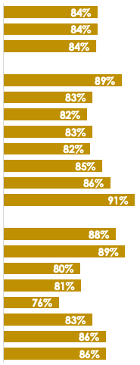
Course Completion
& Retention
2021-22
Completion*
Retention*
*Excludes MW & EW Grades
Notes:
Dr. Garcia to spend 2 minutes on this slide

Slide 15
Transfer

Slide 16
Overview of Research
Service Area Demographics (Albany, Berkeley, Emeryville, Oakland)
  Future Pipeline of Students from feeder schools
  Poverty & Living Wage scan
  Career & employment projections
Summary from Research Reports and Literature
  Barriers to student success
  Programs and initiatives that enabled student success focused on poverty, equity, and gentrification.

Slide 17
Service Area Feeder School Demographics
Students Enrolled in Community College
4,911
902
(18%)
4,809
879
(18%)
4,516
900
(20%)
4,566
817
(18%)
Alameda County
18%
Albany, Emeryville,
Berkeley, Oakland
2014-15
2015-16
2016-17
2017-18
* Most recent data provided by California Department of Education, Data Quest.
Notes:
We’ll add adult ed pipeline

Slide 18
Percent of Socioeconomically Disadvantaged HS Students From Albany, Berkeley, Emeryville, and Oakland Attending Community College in 2017-18
Average of 73% of Albany, Berkeley, Emeryville, and Oakland public school students who attend a California community college are socioeconomically disadvantaged (AY 2017-2018)
CA Dept. of Ed.

Slide 19
Service Area Enrollment Pipeline
% Student Population Change Relative to Grade 12 from 2021-22
 | YR-2022 | YR-2023 | YR-2024 | YR-2025 | YR-2026 | YR-2027
Ethnicity | Grade 12 | Grade 11 | Grade 10 | Grade 9 | Grade 8 | Grade 7
African American | 1,000 | -13% | -11% | -18% | -11% | -15%
American Indian/Native Alaskan | 18 | -39% | -61% | -39% | -44% | -39%
Asian | 615 | -12% | 17% | -20% | -16% | -13%
Filipino | 52 | -23% | -29% | -31% | -37% | -37%
Latinx | 2,088 | -1% | -1% | 2% | -6% | -11%
Pacific Islander | 32 | -19% | 3% | 0% | 19% | 13%
White | 794 | -13% | -15% | -12% | -14% | -22%
Two or More | 293 | 1% | 11% | 10% | 3% | 16%
Not Reported | 94 | -4% | -3% | 19% | -32% | 7%
Total | 4,986 | -7% | -7% | -7% | -10% | -12%
Albany, Berkeley, Emeryville, and Oakland K-12 public school data suggests a potential increase in student populations shown in green. The percent changes are relative to Grade 12 from 2021-22.
29% of Albany, 18% of Berkeley, 30% of Emeryville, and 29% of Oakland public high school completers attend a community college.
CA Dept. of Ed.

Slide 20
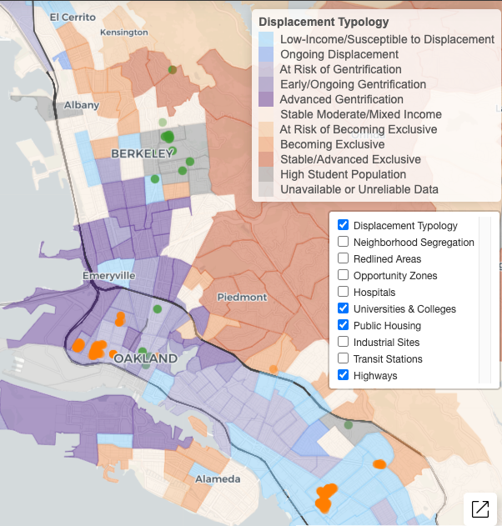

Gentrification
Albany HS
In 2018, over 10% or 161,343 low income households (living below 80% of the area’s median income) were at risk of or currently experiencing gentrification.
Nearly half of these households live in either Alameda or San Francisco counties.
Ongoing and advanced gentrification is most prevalent in San Francisco (18.5% of all tracts) and Alameda (11.1% of tracts) counties.
Berkeley HS
Emery HS
Oakland Tech HS
McClymonds HS
Street Academy HS
MetWest HS
Oakland HS
Fremont HS
Urban Displacement Project (UC Berkeley)
Notes:
Borders = census track
*ami - area median income

Slide 21
Living Wage Revised
Population by ethnicity living below poverty for Albany, Berkeley, Emeryville, and Oakland
 | Total Population |  | % In Poverty of the Total Population
 | 2010 | 2020 | 2010 | 2020
White alone | 176,040 | 196,146 | 13.3% | 9.3%
Black or African American alone | 119,887 | 103,715 | 26.7% | 21.1%
American Indian or Alaska Native alone | 1,505 | 1,637 | 0.0% | 17.0%
Asian alone | 95,136 | 104,668 | 23.8% | 19.6%
Native Hawaiian or Pacific Islander alone | 2,299 | 2,969 | 0.0% | 16.7%
Some other race alone | 1,865 | 4,367 | 27.6% | 20.1%
Two or more races | 21,096 | 36,680 | 15.3% | 12.5%
Hispanic or Latino origin (of any race) | 114,095 | 147,961 | 26.8% | 17.1%
Total | 531,923 | 598,143 | 21.1% | 15.4%
US Census poverty threshold = $17,420/yr for a two person household
A living wage in Alameda County - per the MIT living wage calculator = $103,093/yr for one adult and one child before taxes.
Alameda County living wage: An adult plus one infant living require an annual wage of $96,986 after taxes. (The Insight Center for Community Economic Development Family Needs Calculator)
US Census Data

Slide 22
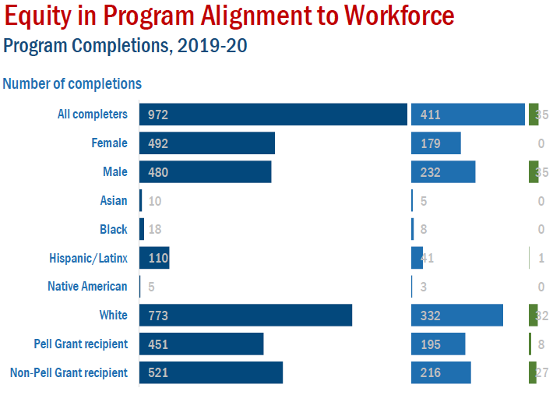
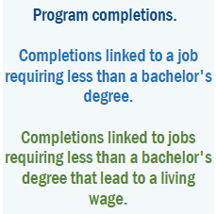
42%
4%
36%
48%
7%
50%
44%
37%
1%
60%
43%
4%
2%
41%
5%
Notes:
A living wage is a wage which provides necessities for one adult and one child without relying on public assistance.
Living wage in CA = $83,907
Tennessee = $54,704

Slide 23
Median Wage
Median Earnings Data (US Census)
Earnings in the Past 12 Months (S2001)
Academic Attainment | Albany | Berkeley | Emeryville | Oakland
Less than high school graduate | $32,009 | $22,857 | $55,347 | $25,559
High school graduate | $39,931 | $32,972 | $34,700 | $31,493
Some college or associate's degrees | $41,458 | $36,165 | $55,568 | $38,498
Bachelor's degree | $65,823 | $56,541 | $86,485 | $68,369
Graduate or professional degree | $86,115 | $81,742 | $92,865 | $87,464
US Census Data

Slide 24
Career Salary & Projected Growth
Highest paying jobs for graduates with an associate’s degree and their projected growth through 2030.
-US News analysis of Bureau of Labor Statistics (BLS)
Reference: US News
Career | 2020 Median Salary | Projected Growth Thru 2030
Geological and hydrologic technicians | $50,630 | 9%
Medical Equipment Repairers | $51,610 | 7%
Environmental engineering technologists and technicians | $51,630 | 8%
Life, physical, and social science technicians | $52,460 | 8%
Paralegals or legal assistants | $52,920 | 12%
Civil engineering technologists and technicians | $54,080 | 2%
Computer network support specialists | $55,510 | 9%
Radio, cellular and tower equipment installers and repairers | $57,720 | 4%
Drafters | $57,960 | -2%
Funeral Service Workers | $58,170 | 4%
Mechanical engineering technologists and technicians | $58,230 | 6%
Legal support workers | $59,540 | Flat
Electro-mechanical technicians (robotics) | $59,800 | -2%

Slide 25
Career Salary & Projected Growth
Career | 2020 Median Salary | Projected Growth Thru 2030
Occupational therapy assistants | $60,950 | 34%
Respiratory therapists | $62,810 | 23%
Radiologic and MRI technologists | $63,710 | 9%
Aircraft and avionics mechanics and technicians | $66,680 | 11%
Aerospace engineering and operations technologists and technicians | $68,570 | 9%
Diagnostic medical sonographers and cardiovascular technologists and technicians | $70,380 | 14%
Dental hygienists | $77,090 | 11%
Web developers and digital interface designers | $77,200 | 13%
Nuclear medicine technologists | $79,590 | 8%
Nuclear technicians | $84,190 | -12%
Radiation therapists | $86,850 | 9%
Air traffic controllers | $130,420 | 4%
Reference: US News

Slide 26
Awards & Wages
Top ten (10) paying jobs for an associate’s degree or certificate holders.
(Basis: Median wage 5 years after award. Award years 2010-2011 to 2014-2015.)
Data Mart Wage Tracker
Jobs | Award Category | Median Wage 5 Years After Award (2010-11 to 2014-15)
Electrical Systems and Power Transmission | Certificates Recipient | $159,160
Physicians Assistant | AA/AS Degree Recipient | $144,225
Physicians Assistant | Certificates Recipient | $141,727
Educational Technology | Locally Approved Certificates Recipient | $124,377
Electrical-095220 | Locally Approved Certificates Recipient | $119,918
*CCCCO Management Information Systems Data Mart Wage Tracker
Notes:
Cohort Group:
The Wage Outcomes cohort is the set of students who received an awards over a period of five consecutive academic years who had not transferred to a four year institution, were not enrolled anywhere in the California Community College system after receiving an award and were older than 21 at time of award

Slide 27
Employment Wages
Data Mart Wage Tracker
Jobs | Award Category | Median Wage 5 Years After Award (Award Years 2010-2011 to 2014-2015)
Paramedic | Chancellor's Office Approved Certificates Recipient | $112,609
Diagnostic Medical Sonography | Chancellor's Office Approved Certificates Recipient | $111,504
Fire Technology | Locally Approved Certificates Recipient | $106,303
Public Works | Chancellor's Office Approved Certificates Recipient | $102,898
Surveying | Chancellor's Office Approved Certificates Recipient | $100,629

Slide 28
Employment Wages: Career Education
Top three (3) paying jobs for an associate’s degree or certificate holders.
(Basis: Median wage 5 years after award. Award years 2010-2011 to 2014-2015.)
Job | Award Category | Median Wage 5 Years After Award (Award Years 2010-2011 to 2014-2015)
Electrical Systems and Power Transmission | Chancellor's Office Approved Certificates | $159,160
Educational Technology | Locally Approved Certificates | $124,377
Electrical | Locally Approved Certificates | $119,918
Digital Media | AA | $46k
 | Chancellor's Approved Certificate | $50k
 | Locally Approved Certificate | $21k
Multimedia | AA | $36k
 | Chancellor's Approved Certificate | $39k
Data Mart Wage Tracker

Slide 29
Employment Wages: Arts/Humanities/Social Sciences
Top three (3) paying jobs for an associate’s degree or certificate holders.
(Basis: Median wage 5 years after award. Award years 2010-2011 to 2014-2015.)
Jobs | Award Category | Median Wage 5 Years After Award (2010-11 to 2014-15)
Geographic Information Systems | Chancellor's Office Approved Certificates Recipient ($74k), AA (~$58.8k) | $58,778 - $74,440
Economics | AA/AS Degree Recipient | $55,708
Speech Communication | Locally Approved Certificates Recipient | $54,865
Data Mart Wage Tracker

Slide 30
Employment Wages: STEM
Top three (3) paying jobs for an associate’s degree or certificate holders are given on the following slides. (Basis: Median wage 5 years after award. Award years 2010-2011 to 2014-2015.)
Jobs | Award Category | Median Wage 5 Years After Award (Award Years 2010-2011 to 2014-2015)
Physics, General | AA/AS Degree Recipient | $69,639
Biotechnology and Biomedical Technology | AA/AS Degree Recipient | $64,439
Mathematics, General | AA/AS Degree Recipient | $60,163
Data Mart Wage Tracker

Slide 31
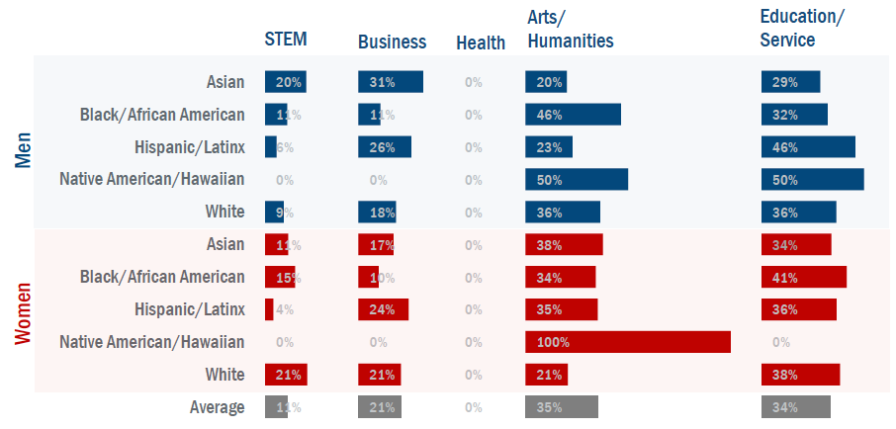
Associate Degrees by Ethnicity & Gender
Historically marginalized students are often less likely to choose programs of study in high wage fields. Colleges working to ensure access to programs that lead to higher wage jobs (STEM, Business, Health) can reduce the earnings gap while developing a diverse workforce.
Notes:
On average, most BCC students selected lower wage fields (Arts/Humanities and Education/Service).
The lowest percentage of groups in the STEM field include: Latinx men (6%), Native American/Hawaiian men (0%), White men (9%), Latinx women (4%), and Native American/Hawaiian women (0%).
Black/African American men ( and Native American/Hawaiian men; Native American/Hawaiian women

Slide 32
Student Success: Key Takeaways from Research
Non-academic obstacles might be key drivers of dropout rates for low-income students.
Survey of 6,000 community college students from 10 community colleges in California and 8 other states conducted by North Carolina State University revealed the top ten (10) challenges to student success.
Work (34%)
Paying expenses (34%)
Meeting demands of family and friends (30%)
Online classes, e.g. difficulty learning material on their own, lack of interaction with faculty (21%)
Parking on campus (21%)
Developmental courses, courses were too hard (17%)
Faculty (16%)
Health and disability (16%)
Doing college-level work (15%)
Registering for courses (14%)
*Percentages do not add to 100% as students could choose more than one option
RISC Report (Fall 2017 & Fall 2018; Published 2019)

Slide 33
Online Course Success
UC Davis School of Education’s analysis of California Community College Data suggests
  On average, students have poorer outcomes in online courses in terms of the likelihood of course completion, course completion with a passing grade, and receiving an A or B.
  Students are more likely to repeat courses taken online, but are less likely to take new courses in the same subject following courses taken online.
  At BCC in 2021-22, completion rate for online classes was 70% vs. 71% in-person.
    Female students: 70% online vs. 75% in-person;
    White students: 74% online vs. 80% in-person;
    Pacific Islander students: 55% online (44 students) vs. 100% in-person (6 students).
Online Course-taking and Student Outcomes in California Community Colleges. Education Finance and Policy

Slide 34
Internships
Key Takeaways
Sample of 12,220 college graduates (2013-2015)
  Unpaid internships were correlated to positive outcomes in the areas of confirming or rejecting career interests, setting and attaining career goals, quality of supervision, and networking.
    In the latter two categories, unpaid internships proved to be slightly more impactful than paid internship experiences (although both were significant).
  Notably, unpaid internships were rated as being significantly beneficial to gains in understanding academic coursework, while paid internships were not rated as significant in this area.
National Association of Colleges and Employers
Sample of 579 graduating business seniors
  Securing full-time employment by graduation is more positively related to having paid internships/co-ops.
  Being self-employed by graduation is more positively related to having unpaid internships/co-ops.
  Completing a professional development course earlier in one’s college program was found to be positively related to both types of internships/co-ops.
Journal of Education for Business

Slide 35
Mental Health Services & Outcomes
Limited Data Is Available on Mental Health Utilization and Outcomes.
In 2019-20, UC campuses collectively provided counseling services to about 34,000 students (12 percent of total UC enrollment) and psychiatry services to about 6,400 students (2 percent of total UC enrollment).
CCC recently began collecting utilization data, reporting that about 59,000 students (2 percent of total CCC enrollment) received any mental health services in 2019-20.
Across the segments, data is not available on the impact of mental health services on students’ academic or clinical outcomes.
Measuring the outcomes of mental health services remains a challenge among all providers, not only college campuses.
Academic and health practitioners have not yet developed an agreed-upon set of measurable mental health outcomes that are consistently reported.
California Legislative Analyst's Office

Slide 36
Mental Health Services & Outcomes
Anxiety continues to be the most frequent concern among college counseling center clients
The most frequent concern for counseling center clients were:
  anxiety (58.9%)
  depression (48.0%)
  stress (46.9%)
  specific relationship problems (29.5%)
  family concerns (29.0%)
  suicidal thoughts (28.4%)
  academic performance difficulties (28.2%)
  sleep disturbance (19.1%)
  social isolation / loneliness (18.5%)
  significant previous mental health treatment history (16.5%)
  adjustment to a new environment (15.8%)
Counseling services have a positive impact on academics, as measured by student self-report:
  65.8% of clients stated that counseling services helped with their academic performance
  63.2% of clients stated that counseling services helped them stay in school
Association for University and College Counseling Center Directors

Slide 37
Human Capital Development
Key Takeaways: Employee Retention
Benchmark statistics
Turnover at Associate's Institutions
  Exempt 12% (Associates)/13% (Other Higher Ed Institutions)
  Non-Exempt 12% (Associates)/16% (Other Institutions, Higher Ed)
  HR ~11% (Associates)/9% (Other Higher Ed Institutions)
Community and University Professional Association for Human Resources

Slide 38
Human Capital Development
Key Takeaways, Employee Retention
The study population included all full-time faculty members employed by an urban community college in the southeastern U.S. Survey responses from 66% (N = 149) of the invited population revealed that organizational support for innovation had the strongest effect on turnover intent. Faculty who reported higher levels of support for innovation were less likely to indicate intentions to leave. Findings suggest that community colleges can target innovation and organizational change as vehicles for enhancing faculty retention rates. Change initiatives related to curriculum, governance, and faculty development can be designed in ways that facilitate faculty commitment to the institution.
Community College Journal of Research and Practice
Employees most commonly leave because they feel undervalued, especially higher education where the professional staff within the student service offices that students commonly interact with are often well educated (Master’s degrees or above) and well trained (through professional development and yearly departmental training) but are paid minimal salaries (often just above entry level pay)
According to studies published by the Carey School of Business at Arizona State University (ASU), for example, increasing worker wages is one way to prevent turnover. The research indicated that when workers were given a 15 percent wage increase, the volume of corresponding turnovers decreased by 13 percent.
Ed News Daily

Slide 39
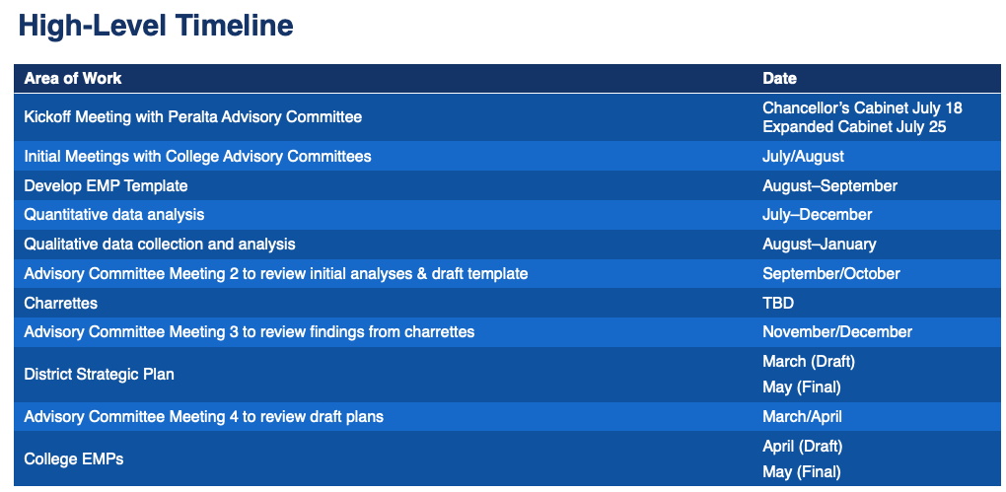
WestEd EMP Support Timeline

Slide 40
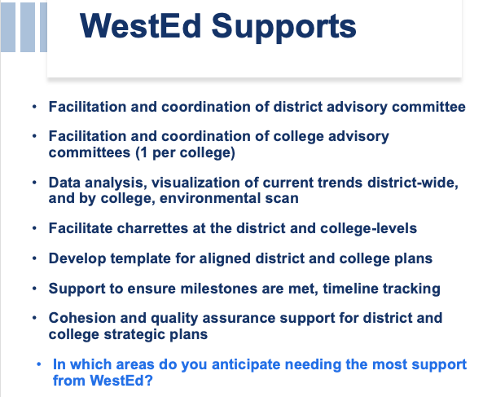

Slide 41
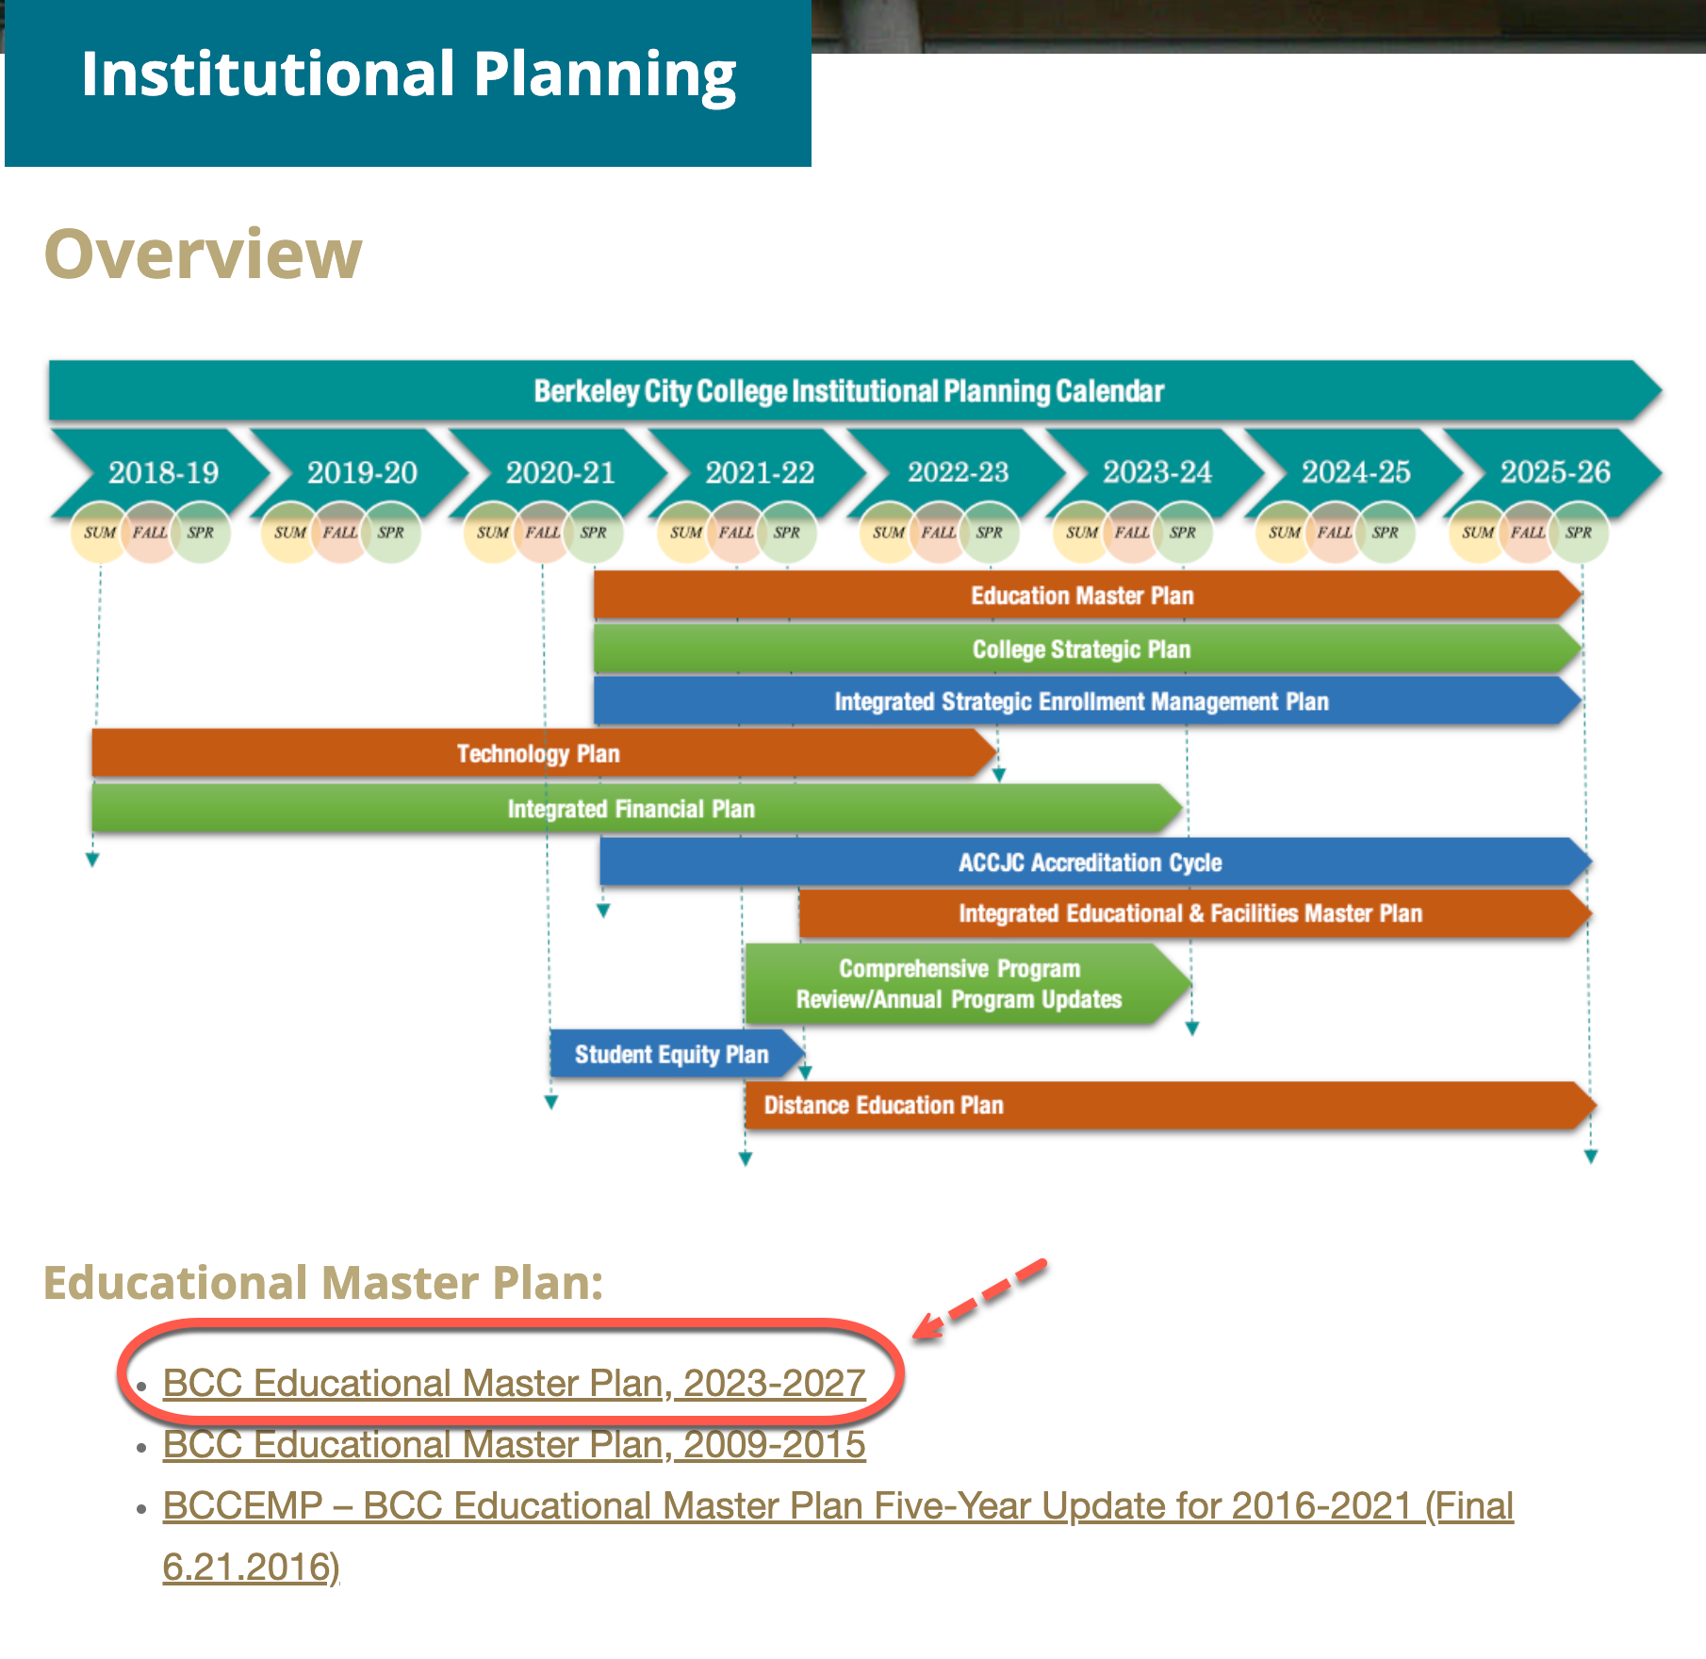
Thank you!
Leave Feedback
View EMP Documents
Notes:
Feedback: https://bcc.az1.qualtrics.com/jfe/form/SV_88PoLcp4ESj9fsa
Institutional Planniing: https://www.berkeleycitycollege.edu/prm/bcc-plans/

Slide 42
Questions?

Slide 43
Addendum
The following slides provide information based on questions and feedback from the President and her Cabinet during the August 2, 2022 EMP meeting.

Slide 44
Wage Data
Household Median Income (in 2020 Inflation Adjusted Dollars)
Albany | Household Median Income
White | $112,181
Black or African America | No data
American Indian and Alaska Native | No data
Asian | $92,786
Native Hawaiian and Other Pacific Islander | No data
Some other race | $47,981
Two or more races | $131,528
Hispanic or Latino origin (of any race) | $86,746
White alone (not Hispanic or Latino | $113,350
US Census

Slide 45
Wage Data
Household Median Income (in 2020 Inflation Adjusted Dollars)
Berkeley | Median Household Income
White | $116,071
Black or African America | $39,390
American Indian and Alaska Native | No data
Asian | $61,268
Native Hawaiian and Other Pacific Islander | $16,627
Some other race | $56,467
Two or more races | $75,855
Hispanic or Latino origin (of any race) | $68,924
White alone (not Hispanic or Latino | $119,522
US Census

Slide 46
Wage Data
Household Median Income (in 2020 Inflation Adjusted Dollars)
Emeryville | Median Household Income
White | $110,041
Black or African America | $55,000
American Indian and Alaska Native | No data
Asian | $131,955
Native Hawaiian and Other Pacific Islander | No data
Some other race | $72,344
Two or more races | $68,313
Hispanic or Latino origin (of any race) | $74,750
White alone (not Hispanic or Latino | $110,795
US Census

Slide 47
Wage Data
Household Median Income (in 2020 Inflation Adjusted Dollars)
Oakland | Median Household Income
White | $118,535
Black or African America | $49,102
American Indian and Alaska Native | $70,844
Asian | $69,857
Native Hawaiian and Other Pacific Islander | $62,313
Some other race | $57,244
Two or more races | $92,095
Hispanic or Latino origin (of any race) | $67,928
White alone (not Hispanic or Latino) | $123,717
US Census

Slide 48
Educational Attainment
Albany | Total | Percent
White alone | 7,070 | (X)
High school graduate or higher | 6,899 | 97.60%
Bachelor's degree or higher | 5,492 | 77.70%
White alone, not Hispanic or Latino | 6,565 | (X)
High school graduate or higher | 6,427 | 97.90%
Bachelor's degree or higher | 5,225 | 79.60%
Black alone | 513 | (X)
High school graduate or higher | 474 | 92.40%
Bachelor's degree or higher | 230 | 44.80%
American Indian or Alaska Native alone | 103 | (X)
High school graduate or higher | 89 | 86.40%
Bachelor's degree or higher | 39 | 37.90%
Asian alone | 4,534 | (X)
High school graduate or higher | 4,327 | 95.40%
Bachelor's degree or higher | 3,479 | 76.70%
Albany | Total | Percent
Native Hawaiian and Other Pacific Islander alone | 32 | (X)
High school graduate or higher | 32 | 100.00%
Bachelor's degree or higher | 8 | 25.00%
Some other race alone | 561 | (X)
High school graduate or higher | 401 | 71.50%
Bachelor's degree or higher | 231 | 41.20%
Two or more races | 1,106 | (X)
High school graduate or higher | 1,089 | 98.50%
Bachelor's degree or higher | 654 | 59.10%
Hispanic or Latino Origin | 1,510 | (X)
High school graduate or higher | 1,337 | 88.50%
Bachelor's degree or higher | 769 | 50.90%
Year 2020 Estimates
US Census

Slide 49
Educational Attainment
Berkeley | Total | Percent
White alone | 50,806 | (X)
High school graduate or higher | 50,032 | 98.50%
Bachelor's degree or higher | 40,944 | 80.60%
White alone, not Hispanic or Latino | 47,961 | (X)
High school graduate or higher | 47,422 | 98.90%
Bachelor's degree or higher | 39,144 | 81.60%
Black alone | 6,725 | (X)
High school graduate or higher | 6,161 | 91.60%
Bachelor's degree or higher | 1,933 | 28.70%
American Indian or Alaska Native alone | 579 | (X)
High school graduate or higher | 337 | 58.20%
Bachelor's degree or higher | 84 | 14.50%
Asian alone | 12,623 | (X)
High school graduate or higher | 12,069 | 95.60%
Bachelor's degree or higher | 9,929 | 78.70%
Berkeley | Total | Percent
Native Hawaiian and Other Pacific Islander alone | 300 | (X)
High school graduate or higher | 300 | 100.00%
Bachelor's degree or higher | 56 | 18.70%
Some other race alone | 2,649 | (X)
High school graduate or higher | 2,264 | 85.50%
Bachelor's degree or higher | 1,120 | 42.30%
Two or more races | 4,696 | (X)
High school graduate or higher | 4,489 | 95.60%
Bachelor's degree or higher | 3,266 | 69.50%
Hispanic or Latino Origin | 6,910 | (X)
High school graduate or higher | 5,992 | 86.70%
Bachelor's degree or higher | 3,342 | 48.40%
Year 2020 Estimates
US Census

Slide 50
Educational Attainment
Emeryville | Total | Percent
White alone | 4,582 | (X)
High school graduate or higher | 4,518 | 98.60%
Bachelor's degree or higher | 3,417 | 74.60%
White alone, not Hispanic or Latino | 4,040 | (X)
High school graduate or higher | 4,008 | 99.20%
Bachelor's degree or higher | 3,072 | 76.00%
Black alone | 1,552 | (X)
High school graduate or higher | 1,517 | 97.70%
Bachelor's degree or higher | 725 | 46.70%
American Indian or Alaska Native alone | 26 | (X)
High school graduate or higher | 26 | 100.00%
Bachelor's degree or higher | 15 | 57.70%
Asian alone | 2,885 | (X)
High school graduate or higher | 2,724 | 94.40%
Bachelor's degree or higher | 2,357 | 81.70%
Emeryville | Total | Percent
Native Hawaiian and Other Pacific Islander alone | 45 | (X)
High school graduate or higher | 45 | 100.00%
Bachelor's degree or higher | 11 | 24.40%
Some other race alone | 272 | (X)
High school graduate or higher | 272 | 100.00%
Bachelor's degree or higher | 188 | 69.10%
Two or more races | 501 | (X)
High school graduate or higher | 483 | 96.40%
Bachelor's degree or higher | 392 | 78.20%
Hispanic or Latino Origin | 1,083 | (X)
High school graduate or higher | 1,033 | 95.40%
Bachelor's degree or higher | 736 | 68.00%
Year 2020 Estimates
US Census

Slide 51
Educational Attainment
Oakland | Total | Percent
White alone | 116,761 | (X)
High school graduate or higher | 109,438 | 93.70%
Bachelor's degree or higher | 81,090 | 69.40%
White alone, not Hispanic or Latino | 101,032 | (X)
High school graduate or higher | 98,177 | 97.20%
Bachelor's degree or higher | 75,921 | 75.10%
Black alone | 70,559 | (X)
High school graduate or higher | 63,397 | 89.80%
Bachelor's degree or higher | 20,715 | 29.40%
American Indian or Alaska Native alone | 2,460 | (X)
High school graduate or higher | 2,085 | 84.80%
Bachelor's degree or higher | 590 | 24.00%
Asian alone | 54,382 | (X)
High school graduate or higher | 41,445 | 76.20%
Bachelor's degree or higher | 22,465 | 41.30%
Oakland | Total | Percent
Native Hawaiian and Other Pacific Islander alone | 1,952 | (X)
High school graduate or higher | 1,587 | 81.30%
Bachelor's degree or higher | 438 | 22.40%
Some other race alone | 43,720 | (X)
High school graduate or higher | 25,330 | 57.90%
Bachelor's degree or higher | 6,979 | 16.00%
Two or more races | 19,408 | (X)
High school graduate or higher | 17,546 | 90.40%
Bachelor's degree or higher | 10,174 | 52.40%
Hispanic or Latino Origin | 68,403 | (X)
High school graduate or higher | 43,955 | 64.30%
Bachelor's degree or higher | 15,563 | 22.80%
Year 2020 Estimates
US Census

Slide 52
Wage Data
National Wage Data Shown in Inflation Adjusted Dollars
White | Median Annual Earnings
Median annual earnings, all education levels | $52,750
Less than high school completion | $33,450
High school completion | $39,730
Some college, no degree | $41,880
Associate's degree | $45,000
Bachelor's or higher degree | $63,650
Bachelor's degree | $59,970
Master's or higher degree | $69,660
Black | Median Annual Earnings
Median annual earnings, all education levels | $39,820
Less than high school completion | $27,160
High school completion | $34,030
Some college, no degree | $36,950
Associate's degree | $34,930
Bachelor's or higher degree | $51,590
Bachelor's degree | $50,030
Master's or higher degree | $53,340
Hispanic | Median Annual Earnings
Median annual earnings, all education levels | $39,960
Less than high school completion | $29,810
High school completion\1\ | $34,000
Some college, no degree | $37,860
Associate's degree | $40,500
Bachelor's or higher degree | $52,690
Bachelor's degree | $49,910
Master's or higher degree | $59,230
Asian | Median Annual Earnings
Median annual earnings, all education levels | $70,040
Less than high school completion | Too few cases
High school completion\1\ | $38,820
Some college, no degree | $35,590
Associate's degree | $50,840
Bachelor's or higher degree | $76,920
Bachelor's degree | $69,490
Master's or higher degree | $84,780
Two or more races | Median Annual Earnings
Median annual earnings, all education levels | $47,510
Less than high school completion | Too few cases
High school completion\1\ | $39,740
Some college, no degree | $42,750
Associate's degree | $39,610
Bachelor's or higher degree | $50,000
Bachelor's degree | $49,250
Master's or higher degree | $59,420
Median annual earnings for other race groups, all education levels
Pacific Islander | $40,380
American Indian/Alaska Native | $31,880
National Center for Education Statistics

