Slide 1
  EDUCATIONAL MASTER PLAN
  2024 - 2028
ASBCC: October 20, 2022
Dr. Phoumy Sayavong
Senior Research & Planning Analyst
Dr. Becky Gee
Chemistry Faculty, Researcher

Slide 2
Cabinet Retreat Outcomes
Developed Preliminary EMP Goals
The DREAMing session themes included
  Commitment to students,
  Culturally and industry-relevant programs/services,
  Collaborative community partnerships,
  Focus on student access, success, and equitable outcomes.
Amidst the context of a post-pandemic society, topics included:
  Access to high wage, high skills job training,
  Partnerships with local industries for impactful work experience for BCC students,
  Student and employee health (physical, mental, fiscal),
  Community partnerships to generate affordable housing opportunities,
  Developing a truly “free college for all”.
Berkeley City College aims to prioritize and pursue initiatives that lead to higher-wage jobs for students from historically marginalized and low-income backgrounds to achieve the goal of ending poverty and gentrification.
BCC President’s Report

Slide 3
Preliminary Strategic Priorities for EMP
Student Completion
Teaching and Learning
Data-Informed Processes & Innovations
Community Partnerships
Human Capital Development
Fiscal Sustainability
Diversity, Equity, Inclusion & the Global Community
Advanced Technology & Facilities
BCC President’s Report

Slide 4
BCC ENROLLMENT TREND
HEADCOUNT
10,976
+4%
11,427
-11%
10,137
FTES
3,697
-12%
3,263
-19%
2,628
% FT @ BCC
11%
8%
11%
GENDER

Slide 5
Demographics: Ethnicity
Latinx
White
Asian
Black/African American
Two+
Unknown
Pacific Islander
American Indian

Slide 6


Demographics: Age Group

Slide 7
Fall Enrollment Trend (before Census)
-40%
-28%
-38%

Slide 8
Fall Enrollment Trend (after Census)
-19%
-1%
-18%

Slide 9
Fall ‘20 to Spring ‘21 Persistence: First Time Students
Ethnicity | Persistence Rate
American Indian | 33%
Asian | 50%
Black/African American | 43%
Latinx | 50%
Pacific Islander | 0%
Two or More | 54%
Unknown/NR | 48%
White | 57%
Overall First Time Students | 51%
Overall College | 48%
Notes:
Where do they go after in F21? How many of those who persist have BCC as there home school?

Slide 10
COURSE SUCCESS, RETENTION, WITHDRAWAL RATES
Retention: remain enrolled to receive a grade
Passing/Did Not Pass: Among retained students who received a passing or non-passing grade

Slide 11
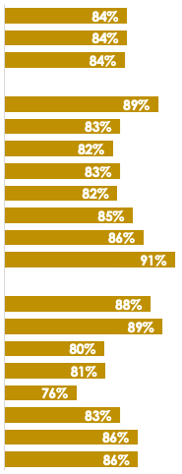
Course Completion
& Retention
2021-22
Completion*
Retention*
*Excludes MW & EW Grades
Notes:
Dr. Garcia to spend 2 minutes on this slide

Slide 12
Transfer

Slide 13
Service Area Feeder School Demographics
Students Enrolled in Community College
4,911
902
(18%)
4,809
879
(18%)
4,516
900
(20%)
4,566
817
(18%)
Alameda County
18%
Albany, Emeryville,
Berkeley, Oakland
2014-15
2015-16
2016-17
2017-18
* Most recent data provided by California Department of Education, Data Quest.
Notes:
We’ll add adult ed pipeline

Slide 14
Percent of Socioeconomically Disadvantaged HS Students From Albany, Berkeley, Emeryville, and Oakland Attending Community College in 2017-18
Average of 73% of Albany, Berkeley, Emeryville, and Oakland public school students who attend a California community college are socioeconomically disadvantaged (AY 2017-2018)
CA Dept. of Ed.

Slide 15
Service Area Enrollment Pipeline
% Student Population Change Relative to Grade 12 from 2021-22
 | YR-2022 | YR-2023 | YR-2024 | YR-2025 | YR-2026 | YR-2027
Ethnicity | Grade 12 | Grade 11 | Grade 10 | Grade 9 | Grade 8 | Grade 7
African American | 1,000 | -13% | -11% | -18% | -11% | -15%
American Indian/Native Alaskan | 18 | -39% | -61% | -39% | -44% | -39%
Asian | 615 | -12% | 17% | -20% | -16% | -13%
Filipino | 52 | -23% | -29% | -31% | -37% | -37%
Latinx | 2,088 | -1% | -1% | 2% | -6% | -11%
Pacific Islander | 32 | -19% | 3% | 0% | 19% | 13%
White | 794 | -13% | -15% | -12% | -14% | -22%
Two or More | 293 | 1% | 11% | 10% | 3% | 16%
Not Reported | 94 | -4% | -3% | 19% | -32% | 7%
Total | 4,986 | -7% | -7% | -7% | -10% | -12%
Albany, Berkeley, Emeryville, and Oakland K-12 public school data suggests a potential increase in student populations shown in green. The percent changes are relative to Grade 12 from 2021-22.
29% of Albany, 18% of Berkeley, 30% of Emeryville, and 29% of Oakland public high school completers attend a community college.
CA Dept. of Ed.

Slide 16
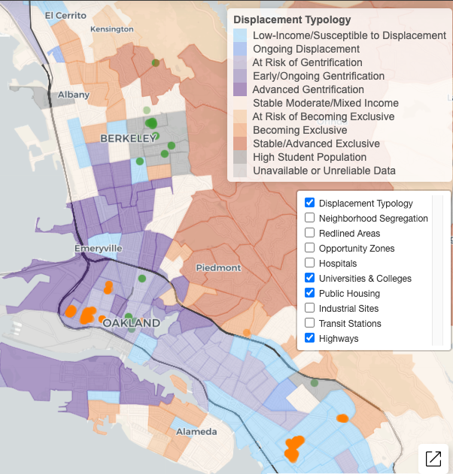

Gentrification
Albany HS
In 2018, over 10% or 161,343 low income households (living below 80% of the area’s median income) were at risk of or currently experiencing gentrification.
Nearly half of these households live in either Alameda or San Francisco counties.
Ongoing and advanced gentrification is most prevalent in San Francisco (18.5% of all tracts) and Alameda (11.1% of tracts) counties.
Berkeley HS
Emery HS
Oakland Tech HS
McClymonds HS
Street Academy HS
MetWest HS
Oakland HS
Fremont HS
Urban Displacement Project (UC Berkeley)
Notes:
Borders = census track
*ami - area median income

Slide 17
Living Wage Revised
Population by ethnicity living below poverty for Albany, Berkeley, Emeryville, and Oakland
 | Total Population |  | % In Poverty of the Total Population
 | 2010 | 2020 | 2010 | 2020
White alone | 176,040 | 196,146 | 13.3% | 9.3%
Black or African American alone | 119,887 | 103,715 | 26.7% | 21.1%
American Indian or Alaska Native alone | 1,505 | 1,637 | 0.0% | 17.0%
Asian alone | 95,136 | 104,668 | 23.8% | 19.6%
Native Hawaiian or Pacific Islander alone | 2,299 | 2,969 | 0.0% | 16.7%
Some other race alone | 1,865 | 4,367 | 27.6% | 20.1%
Two or more races | 21,096 | 36,680 | 15.3% | 12.5%
Hispanic or Latino origin (of any race) | 114,095 | 147,961 | 26.8% | 17.1%
Total | 531,923 | 598,143 | 21.1% | 15.4%
US Census poverty threshold = $17,420/yr for a two person household
A living wage in Alameda County - per the MIT living wage calculator = $103,093/yr for one adult and one child before taxes.
Alameda County living wage: An adult plus one infant living require an annual wage of $96,986 after taxes. (The Insight Center for Community Economic Development Family Needs Calculator)
US Census Data

Slide 18
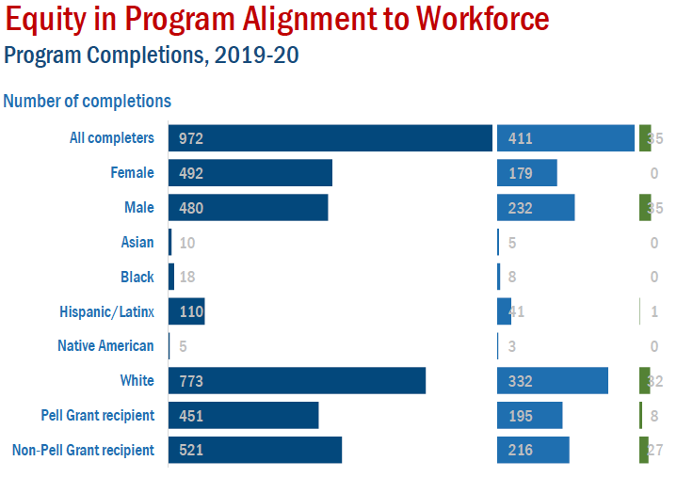
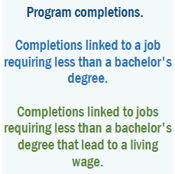
42%
4%
36%
48%
7%
50%
44%
37%
1%
60%
43%
4%
2%
41%
5%
Notes:
A living wage is a wage which provides necessities for one adult and one child without relying on public assistance.
Living wage in CA = $83,907
Tennessee = $54,704

Slide 19
Median Wage
Median Earnings Data (US Census)
Earnings in the Past 12 Months (S2001)
Academic Attainment | Albany | Berkeley | Emeryville | Oakland
Less than high school graduate | $32,009 | $22,857 | $55,347 | $25,559
High school graduate | $39,931 | $32,972 | $34,700 | $31,493
Some college or associate's degrees | $41,458 | $36,165 | $55,568 | $38,498
Bachelor's degree | $65,823 | $56,541 | $86,485 | $68,369
Graduate or professional degree | $86,115 | $81,742 | $92,865 | $87,464
US Census Data

Slide 20
Career Salary & Projected Growth
Highest paying jobs for graduates with an associate’s degree and their projected growth through 2030.
-US News analysis of Bureau of Labor Statistics (BLS)
Reference: US News
Career | 2020 Median Salary | Projected Growth Thru 2030
Geological and hydrologic technicians | $50,630 | 9%
Medical Equipment Repairers | $51,610 | 7%
Environmental engineering technologists and technicians | $51,630 | 8%
Life, physical, and social science technicians | $52,460 | 8%
Paralegals or legal assistants | $52,920 | 12%
Civil engineering technologists and technicians | $54,080 | 2%
Computer network support specialists | $55,510 | 9%
Radio, cellular and tower equipment installers and repairers | $57,720 | 4%
Drafters | $57,960 | -2%
Funeral Service Workers | $58,170 | 4%
Mechanical engineering technologists and technicians | $58,230 | 6%
Legal support workers | $59,540 | Flat
Electro-mechanical technicians (robotics) | $59,800 | -2%

Slide 21
Career Salary & Projected Growth
Career | 2020 Median Salary | Projected Growth Thru 2030
Occupational therapy assistants | $60,950 | 34%
Respiratory therapists | $62,810 | 23%
Radiologic and MRI technologists | $63,710 | 9%
Aircraft and avionics mechanics and technicians | $66,680 | 11%
Aerospace engineering and operations technologists and technicians | $68,570 | 9%
Diagnostic medical sonographers and cardiovascular technologists and technicians | $70,380 | 14%
Dental hygienists | $77,090 | 11%
Web developers and digital interface designers | $77,200 | 13%
Nuclear medicine technologists | $79,590 | 8%
Nuclear technicians | $84,190 | -12%
Radiation therapists | $86,850 | 9%
Air traffic controllers | $130,420 | 4%
Reference: US News

Slide 22
Awards & Wages
Top ten (10) paying jobs for an associate’s degree or certificate holders.
(Basis: Median wage 5 years after award. Award years 2010-2011 to 2014-2015.)
Data Mart Wage Tracker
Jobs | Award Category | Median Wage 5 Years After Award (2010-11 to 2014-15)
Electrical Systems and Power Transmission | Certificates Recipient | $159,160
Physicians Assistant | AA/AS Degree Recipient | $144,225
Physicians Assistant | Certificates Recipient | $141,727
Educational Technology | Locally Approved Certificates Recipient | $124,377
Electrical-095220 | Locally Approved Certificates Recipient | $119,918
*CCCCO Management Information Systems Data Mart Wage Tracker
Notes:
Cohort Group:
The Wage Outcomes cohort is the set of students who received an awards over a period of five consecutive academic years who had not transferred to a four year institution, were not enrolled anywhere in the California Community College system after receiving an award and were older than 21 at time of award

Slide 23
Employment Wages
Data Mart Wage Tracker
Jobs | Award Category | Median Wage 5 Years After Award (Award Years 2010-2011 to 2014-2015)
Paramedic | Chancellor's Office Approved Certificates Recipient | $112,609
Diagnostic Medical Sonography | Chancellor's Office Approved Certificates Recipient | $111,504
Fire Technology | Locally Approved Certificates Recipient | $106,303
Public Works | Chancellor's Office Approved Certificates Recipient | $102,898
Surveying | Chancellor's Office Approved Certificates Recipient | $100,629

Slide 24
Employment Wages: Career Education
Top three (3) paying jobs for an associate’s degree or certificate holders.
(Basis: Median wage 5 years after award. Award years 2010-2011 to 2014-2015.)
Job | Award Category | Median Wage 5 Years After Award (Award Years 2010-2011 to 2014-2015)
Electrical Systems and Power Transmission | Chancellor's Office Approved Certificates | $159,160
Educational Technology | Locally Approved Certificates | $124,377
Electrical | Locally Approved Certificates | $119,918
Digital Media | AA | $46k
 | Chancellor's Approved Certificate | $50k
 | Locally Approved Certificate | $21k
Multimedia | AA | $36k
 | Chancellor's Approved Certificate | $39k
Data Mart Wage Tracker

Slide 25
Employment Wages: Arts/Humanities/Social Sciences
Top three (3) paying jobs for an associate’s degree or certificate holders.
(Basis: Median wage 5 years after award. Award years 2010-2011 to 2014-2015.)
Jobs | Award Category | Median Wage 5 Years After Award (2010-11 to 2014-15)
Geographic Information Systems | Chancellor's Office Approved Certificates Recipient ($74k), AA (~$58.8k) | $58,778 - $74,440
Economics | AA/AS Degree Recipient | $55,708
Speech Communication | Locally Approved Certificates Recipient | $54,865
Data Mart Wage Tracker

Slide 26
Employment Wages: STEM
Top three (3) paying jobs for an associate’s degree or certificate holders are given on the following slides. (Basis: Median wage 5 years after award. Award years 2010-2011 to 2014-2015.)
Jobs | Award Category | Median Wage 5 Years After Award (Award Years 2010-2011 to 2014-2015)
Physics, General | AA/AS Degree Recipient | $69,639
Biotechnology and Biomedical Technology | AA/AS Degree Recipient | $64,439
Mathematics, General | AA/AS Degree Recipient | $60,163
Data Mart Wage Tracker

Slide 27
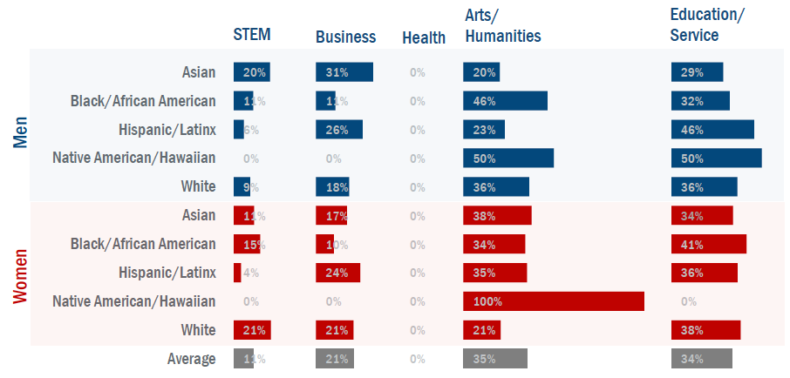
Associate Degrees by Ethnicity & Gender
Historically marginalized students are often less likely to choose programs of study in high wage fields. Colleges working to ensure access to programs that lead to higher wage jobs (STEM, Business, Health) can reduce the earnings gap while developing a diverse workforce.
Notes:
On average, most BCC students selected lower wage fields (Arts/Humanities and Education/Service).
The lowest percentage of groups in the STEM field include: Latinx men (6%), Native American/Hawaiian men (0%), White men (9%), Latinx women (4%), and Native American/Hawaiian women (0%).
Black/African American men ( and Native American/Hawaiian men; Native American/Hawaiian women

Slide 28
Student Success: Key Takeaways from Research
Non-academic obstacles might be key drivers of dropout rates for low-income students.
Survey of 6,000 community college students from 10 community colleges in California and 8 other states conducted by North Carolina State University revealed the top ten (10) challenges to student success.
Work (34%)
Paying expenses (34%)
Meeting demands of family and friends (30%)
Online classes, e.g. difficulty learning material on their own, lack of interaction with faculty (21%)
Parking on campus (21%)
Developmental courses, courses were too hard (17%)
Faculty (16%)
Health and disability (16%)
Doing college-level work (15%)
Registering for courses (14%)
*Percentages do not add to 100% as students could choose more than one option
RISC Report (Fall 2017 & Fall 2018; Published 2019)

Slide 29
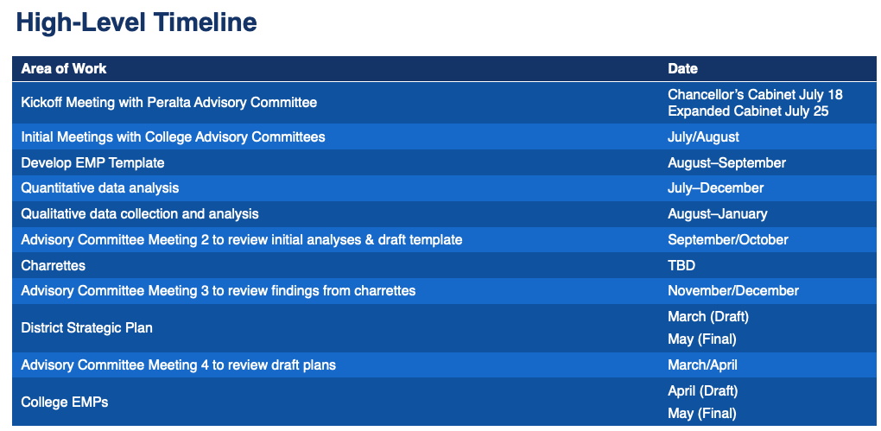
WestEd EMP Support Timeline

Slide 30
Questions?

